Slide 1

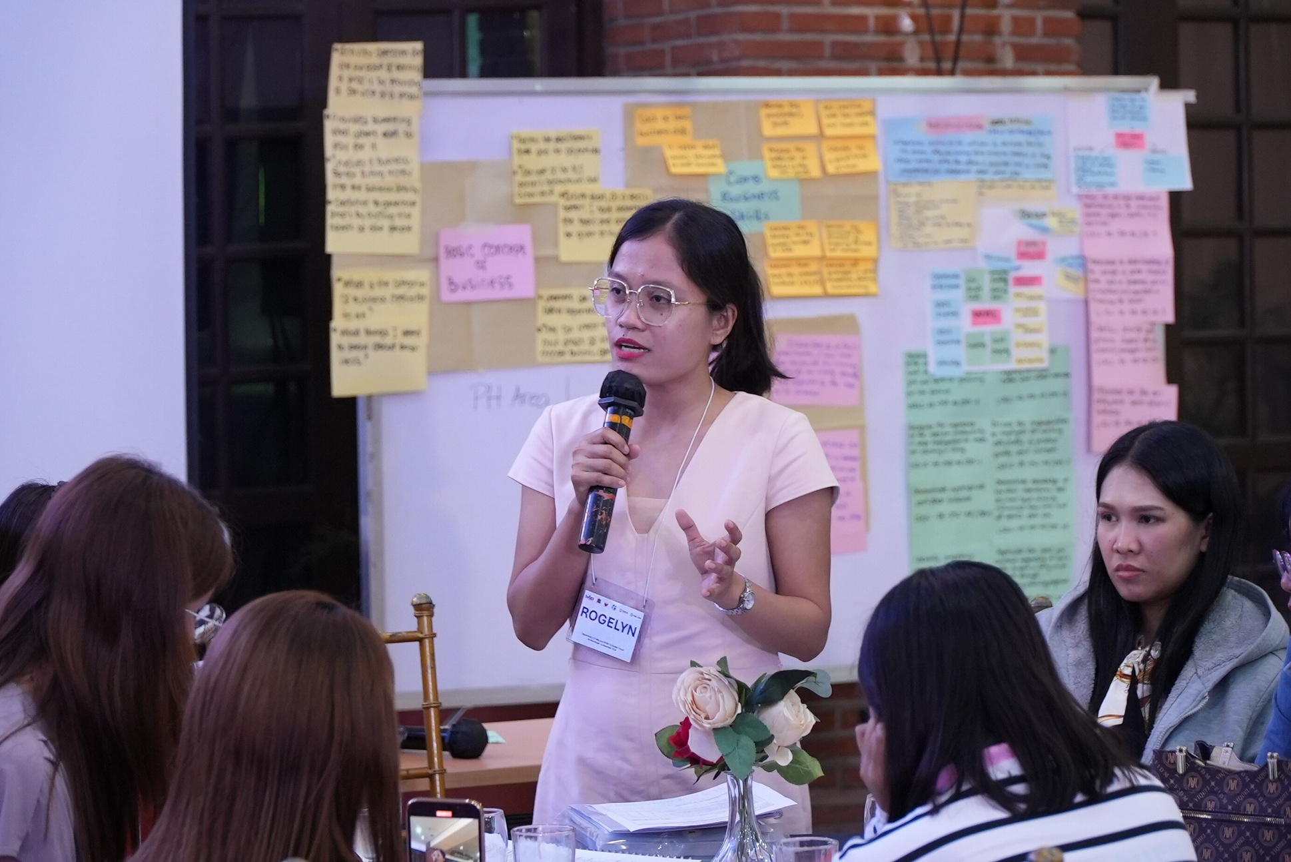

COLLABORATIVE EXPERTISE SESSION (CES) GUIDE ON
Be Your Own Boss
FOR THE DEPARTMENT OF EDUCATION
ALTERNATIVE LEARNING SYSTEM

Slide 2

PRESENTATION FLOW
Purpose of the CES Guide
Parts of the CES guide
Structure of the CES Guides – 4 A’s of Adult Learning
  *Each module starts with the pre- and end with the post-assessment competency checklist.
COLLABORATIVE EXPERTISE SESSION (CES) GUIDE ON BE YOUR OWN BOSS

Slide 3
1. PURPOSE OF THE CES GUIDE
Developed in partnership with the DepEd Bureau of Alternative Education (BAE) and funded by USAID's Opportunity 2.0 Program, this CES guide serves as a resource for ALS teachers. It aids in teaching and supporting learners to achieve employment and livelihood goals.
It emphasizes self-employment and entrepreneurship activities, rooted in the Be Your Own Boss materials developed by the Education Development Center, Inc. as a global resource.
Aligned with the DepEd ALS Curriculum, particularly Learning Strand 4 on Life and Career Skills, Be Your Own Boss allows learners to go through a series of experiential learning. Through these activities, learners gain foundational business skills and foster an entrepreneurial mindset.
COLLABORATIVE EXPERTISE SESSION (CES) GUIDE ON BE YOUR OWN BOSS

Slide 4
1. PURPOSE OF THE CES GUIDE
Content of the guide is largely drawn from the Be Your Own Boss materials developed by the Education Development Center, Inc. as a global resource.
*The CES guide DOES NOT intend to replicate the Be Your Own Boss Facilitator’s Guidebook. It aims to help the implementers use the Be Your Own Boss Facilitator’s Guidebook with more ease and address some feedback and recommendations relevant to the implementation of the Be Your Own Boss activities.
COLLABORATIVE EXPERTISE SESSION (CES) GUIDE ON BE YOUR OWN BOSS

Slide 5
1. PURPOSE OF THE CES GUIDE
Adheres to the Philippine Professional Standards for Teachers (PPST)
  mastery of content knowledge
  creation of safe, secure, and supportive learning environments
  nurturing learner diversity
  use of relevant, collaborative teaching processes and resources
  use of authentic assessment processes and tools
  collaborative engagements
  personal and professional growth
COLLABORATIVE EXPERTISE SESSION (CES) GUIDE ON BE YOUR OWN BOSS

Slide 6
2. PARTS OF THE CES GUIDE
The CES guide consists of the following parts:
Overview of Be Your Own Boss: Links activities to the DepEd ALS Curriculum Learning Strand 4 on Life and Career Skills.
Module 1: What is My Business: Covers business basics, traits of owners, and idea evaluation.
Module 2.A: Customer Service: Focuses on building customer relationships and basic marketing strategies.
COLLABORATIVE EXPERTISE SESSION (CES) GUIDE ON BE YOUR OWN BOSS

Slide 7
2. PARTS OF THE CES GUIDE
Module 2.B: Marketing My Business: Contains basic marketing concepts and practices.
Module 3: Managing My Business and Personal Finance: Teaches financial principles and separating personal and business expenses.
Module 4.A: Writing My Business Plan: Focuses on developing a business plan.
Module 4.B: Presenting My Business Plan: Guides writing and presenting business plans effectively to stakeholders.
COLLABORATIVE EXPERTISE SESSION (CES) GUIDE ON BE YOUR OWN BOSS

Slide 8
3. STRUCTURE OF THE CES GUIDE
Each part follows the 4As of learning:
  Activity: Engages participants by focusing on key concepts and skills related to the Be Your Own Boss materials.
  Analysis: Makes learning meaningful by connecting new information with participants’ existing knowledge.
  Abstraction: Promotes active involvement through hands-on activities, discussions, and collaboration for deeper understanding and retention.
  Application: Develops practical skills, mastery, and the ability to implement Be Your Own Boss activities and assessments.
    Assessment Administration Tips are also included to provide suggestions to CES members on how to roll out the assessments and reflections found in the Be your Own Boss Facilitator's Guides. Moreover, each module starts with the pre- and end with the post-assessment competency checklist.
COLLABORATIVE EXPERTISE SESSION (CES) GUIDE ON BE YOUR OWN BOSS

Slide 9
COLLABORATIVE EXPERTISE SESSION (CES) GUIDE ON
BE YOUR OWN BOSS
OVERVIEW

Slide 10
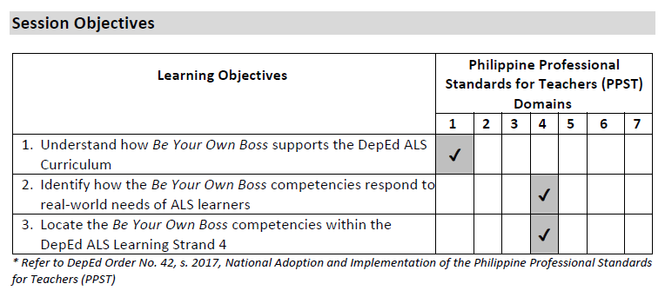
OVERVIEW
OVERVIEW
COLLABORATIVE EXPERTISE SESSION (CES) GUIDE ON BE YOUR OWN BOSS

Slide 11
OVERVIEW
OVERVIEW
Session Prerequisites
This CES does not require any prerequisite knowledge and skills, but it would facilitate the learning session if the CES members are familiar with the DepEd ALS Learning Strand 4 competencies related to entrepreneurship.
Duration
The entire session requires two (2) hours.
COLLABORATIVE EXPERTISE SESSION (CES) GUIDE ON BE YOUR OWN BOSS

Slide 12
OVERVIEW
OVERVIEW
Preliminaries
[Total: 5 minutes]
Welcome the CES members and introduce yourself as the CES leader and/or facilitator. Introduce the rest of the CES, including the facilitator (if necessary), documenter, and members.
Accomplish the Pre-CES Competency Assessment Checklist (Annex A).
Provide an overview of the CES.
Go through the session objectives.
COLLABORATIVE EXPERTISE SESSION (CES) GUIDE ON BE YOUR OWN BOSS

Slide 13
OVERVIEW
OVERVIEW
Activity
[Total: 25 minutes]
This session will utilize a KWL chart to understand how Be Your Own Boss complements the DepEd ALS Learning Strand 4.
Provide each CES member with writing materials, e.g., meta cards and marker pens.
Provide the following prompts in creating the KWL chart (15 minutes):
  Using one meta card for each idea or topic:
    Write an idea or topic that you Know about “Entrepreneurship”.
    Write an idea or topic that you Want to Know about “Entrepreneurship”.
  Provide guide questions to help the CES members recall their knowledge about “Entrepreneurship” or reflect on topics that they want to know:
    What comes to mind right away when you hear the word “Entrepreneurship”?
    What do you think is its main objective/s or purpose?
    What are possible components or practices that contribute to achieving the objective/s?
  Remind the CES members to use one meta card per idea or topic. They can write as many ideas or topics that they can think of within the allotted time.
COLLABORATIVE EXPERTISE SESSION (CES) GUIDE ON BE YOUR OWN BOSS

Slide 14
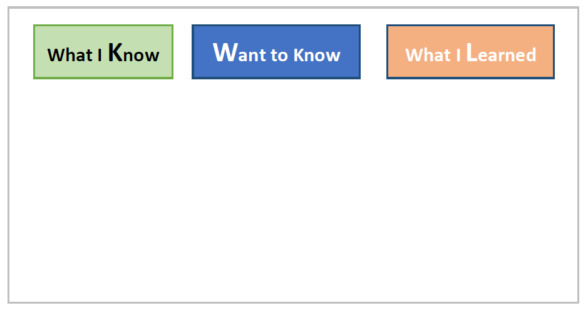
OVERVIEW
OVERVIEW
As the CES facilitator, prepare a board or wall where the CES members can post their meta cards. Prepare a space for “what I Know,” “Want to Know,” and “what I Learned” (to be filled out at the end of the CES).
Ask the CES members to post their meta cards on the board or wall (3-5 minutes per group).
COLLABORATIVE EXPERTISE SESSION (CES) GUIDE ON BE YOUR OWN BOSS

Slide 15
OVERVIEW
OVERVIEW
Analysis
[Total: 15 minutes]
Discuss the following with the CES members:
1. What are the common ideas or topics among the responses?
2. Are there any gaps or misconceptions? What are these?
3. How do you think these ideas or concepts support the ALS Learning Strand 4?
COLLABORATIVE EXPERTISE SESSION (CES) GUIDE ON BE YOUR OWN BOSS

Slide 16
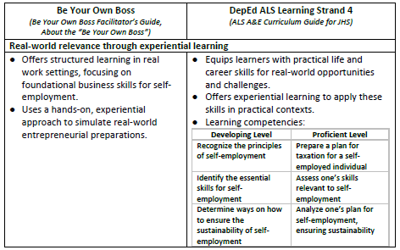
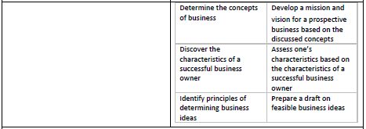
OVERVIEW
OVERVIEW
Abstraction
[Total: 25 minutes]
Building on the output, explain the key features of Be Your Own Boss and how they support the DepEd ALS Learning Strand 4.
COLLABORATIVE EXPERTISE SESSION (CES) GUIDE ON BE YOUR OWN BOSS

Slide 17
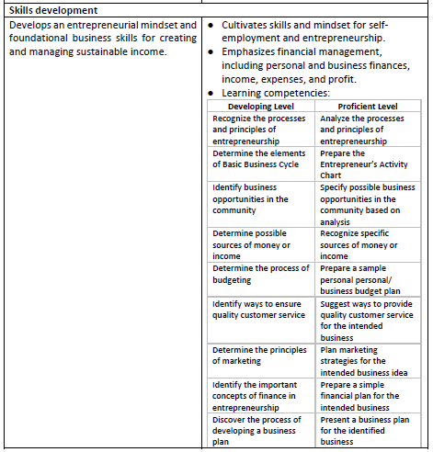
OVERVIEW
OVERVIEW
LEARNING COMPETENCIES
Following the presentation, ask the CES members to revisit their KW(L) chart output, in preparation for the following section.
COLLABORATIVE EXPERTISE SESSION (CES) GUIDE ON BE YOUR OWN BOSS

Slide 18
OVERVIEW
OVERVIEW
Application
[Total: 20 minutes]
Have CES members fill the "What I Learned" section of the KWL chart with ALS Learning Strand 4 competencies from the earlier activity (15 minutes).
Write each competency on a meta card and post it on a wall or board.
Synthesize responses by linking them to tagged competencies in the Be Your Own Boss Facilitator’s Guide (5 minutes per group). Note that not all tagged competencies may surface during the CES. Assure members that this is expected and that they will get more familiar with other competencies as they go throughout the sessions.
COLLABORATIVE EXPERTISE SESSION (CES) GUIDE ON BE YOUR OWN BOSS

Slide 19
OVERVIEW
OVERVIEW
Closing
[Total: 5 minutes]
Review the session objectives together with the CES members. Validate if the objectives were met.
Administer the post-CES Competency Assessment Checklist (Annex B).
If necessary, identify the topic and schedule for the next CES.
Thank the CES members and congratulate them for completing the CES.
Emphasize that they are helping improve the situation of the out-of-school youth and adult learners in the Philippines by their attendance in the session/s.
COLLABORATIVE EXPERTISE SESSION (CES) GUIDE ON BE YOUR OWN BOSS

Slide 20
COLLABORATIVE EXPERTISE SESSION (CES) GUIDE ON
BE YOUR OWN BOSS
MODULE 1
WHAT IS MY BUSINESS?
This CES module complements Module 1 of the Be Your Own Boss Facilitator’s Guide, covering business fundamentals, key traits of business owners, and evaluating viable business ideas.

Slide 21
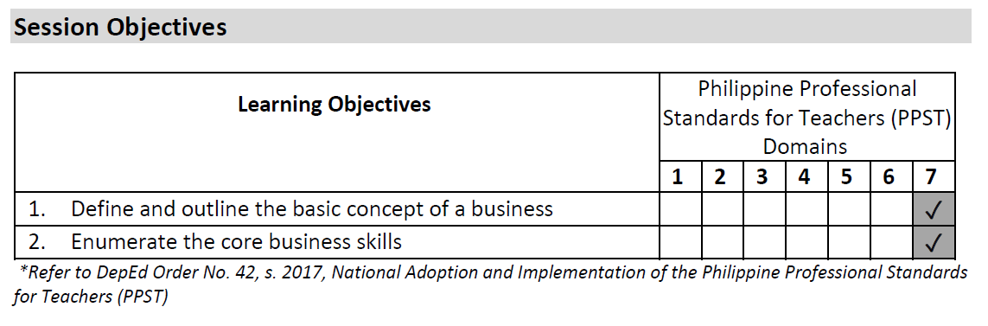
MODULE 1
OVERVIEW
COLLABORATIVE EXPERTISE SESSION (CES) GUIDE ON BE YOUR OWN BOSS

Slide 22
MODULE 1
OVERVIEW
Session Prerequisites
It is ideal that the CES members have already read or browsed relevant sections of the Be Your Own Boss Facilitator’s Guide prior to this CES, particularly:
Activity 1: Basic Concepts of Business
Handout 1.1: Definition of Business and Business Activities
Handout 1.3: Business Categories
Activity 2: Core Business Skills - The Tree Example/Metaphor
Activity 3: Setting Goals
Activity 4: Self-Learning Activity 1: Community Mapping of Business
Duration
The entire session requires approximately two (2) hours.
However, it may require an additional 15-20 minutes to go through all or some of the expanded ideas in each session. These tips may be given as self-directed learning materials to the CES members.
COLLABORATIVE EXPERTISE SESSION (CES) GUIDE ON BE YOUR OWN BOSS

Slide 23
MODULE 1
OVERVIEW
Preliminaries
[Total: 5 minutes]
Accomplish the Pre-CES Competency Assessment Checklist (Annex A).
Provide an overview of the CES module.
Go through the session objectives.
Priming Activity
[Total: 10 minutes]
Have the participants fall in line facing the facilitator.
Present several statements about businesses based on the contents of Handout 1.1: Definition of Business and Business Activities and Handout 1.3: Business Categories.
The participants will assess if the statement is true or false. If they think that the statement is true, the participants will move one step to the right. If the statement is false, the participants will move one step to the left. Those who did not answer correctly are out of the game.
COLLABORATIVE EXPERTISE SESSION (CES) GUIDE ON BE YOUR OWN BOSS

Slide 24
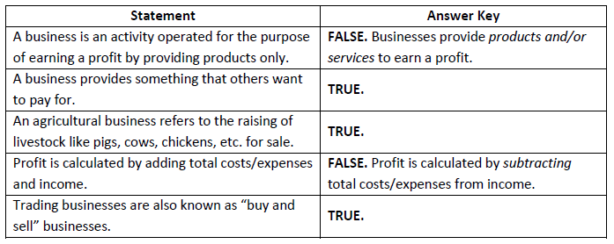
MODULE 1
OVERVIEW
Below are some sample statements that may be used for the game. Feel free to add more:
(Note to the CES facilitator: There is no need to process the CES members’ answers and experience yet. The CES members will have an opportunity to review the materials later.)
Optional:
A reward may be given to the winner.
If the group expresses a desire to further expand their initial ideas regarding business, the CES facilitator may have them try Business Mind Mapping (Annex C).
COLLABORATIVE EXPERTISE SESSION (CES) GUIDE ON BE YOUR OWN BOSS

Slide 25
MODULE 1
OVERVIEW
Main Activity
[Total: 20 minutes]
Divide the CES members into four groups.
Assign each group to one of the four activities under Module 1:
  Activity 1: Basic Concepts of Business
  Activity 2: Core Business Skills - The Tree Example/Metaphor
  Activity 3: Setting Goals
  Activity 4: Self-Learning Activity 1: Community Mapping of Business
Give the CES members 10 minutes to go through their assigned activity, paying close attention to the activity objectives, indicated steps, and provided handouts.
Ask them to summarize the key points of each section into a 10-minute presentation.
COLLABORATIVE EXPERTISE SESSION (CES) GUIDE ON BE YOUR OWN BOSS

Slide 26
MODULE 1
OVERVIEW
Analysis
[Total: 20 minutes]
After their small group discussions and preparation, ask a representative from each group to share their summaries and insights.
After the group presentations, ask and discuss the following:
  What new information have you gained so far that challenged or changed your previous perceptions about different types of businesses?
  How do the activity objectives directly enhance learners’ knowledge about businesses?
  Are the steps outlined sufficient to achieve the objectives and improve learners' understanding of businesses? If not, what modifications would you suggest?
COLLABORATIVE EXPERTISE SESSION (CES) GUIDE ON BE YOUR OWN BOSS

Slide 27
MODULE 1
OVERVIEW
Abstraction
[Total: 20 minutes]
Invite the CES members to share their thoughts on why it is important for ALS learners to know the basic business-related concepts prior to planning their own business (5-10 minutes).
Give examples of other relevant information that ALS learners should also know so they may effectively plan their own business (5 minutes).
Briefly discuss other types of businesses not mentioned in the Be Your Own Boss Facilitator’s Guide.
Example: Online businesses such as reselling from wholesalers, selling homemade food items, content creation, etc.
COLLABORATIVE EXPERTISE SESSION (CES) GUIDE ON BE YOUR OWN BOSS

Slide 28
MODULE 1
MODULE 1
Application
[Total: 20 minutes]
Ask the CES members to go back to the groupings from the previous activities.
Say: Now that we have discussed the basics of businesses and entrepreneurship, let us try to consolidate what we learned and use these to plan upcoming sessions with the ALS learners. Within your small groups, fill out the graphic organizer based on what you picked up from this CES (10 minutes).
COLLABORATIVE EXPERTISE SESSION (CES) GUIDE ON BE YOUR OWN BOSS

Slide 29
MODULE 1
MODULE 1
A statement that answers the basic question: “What do I want my business to become?” [Handout 1.6 (a): Vision and Mission]
Read or review all the necessary materials and activities before meeting the learners (e.g., Module 1 Handout 1.6 (a): Vision and Mission, Handout 1.6 (b): Vision and Mission, etc.)
Review the facilitation guidelines, objectives, and the timeline of sessions
          Take note of the ALS learners’ background and contextualize the discussions as much as possible
Here are sample contents that may be written on the graphic organizer:
Business vision
What do I need to know before starting a business?
How can I prepare myself for entrepreneurship?
Learners can already share general ideas on the kind of business they want to build
Learners will read the relevant handouts (e.g., Handout 1.1: Definition of Business and Business Activities)
COLLABORATIVE EXPERTISE SESSION (CES) GUIDE ON BE YOUR OWN BOSS

Slide 30
MODULE 1
OVERVIEW
Ask at least two groups to briefly share their filled-out graphic organizers with the bigger group.
Say: At the end of each CES, expect to complete graphic organizers—first in groups or pairs, then individually. Maintaining a habit of creating personal organizers afterward is encouraged. You can also take photos of the organizers as references.
COLLABORATIVE EXPERTISE SESSION (CES) GUIDE ON BE YOUR OWN BOSS

Slide 31
MODULE 1
OVERVIEW
Assessment Administration Tips
[Total: 10 minutes]
Have CES members complete the Module 1 Post-Test to assess understanding, address common errors, and write personal reflections on the Reflection Sheet.
Plan how to process Pre-/Post-Tests, Reflection Sheets, and End-of-Module Assessments for clarity and learning.
Assure learners that assessments are not for disqualification but to gauge understanding and provide support.
Use the Facilitator’s Guide and answer keys to address difficult topics, focusing on common mistakes rather than analyzing every item.
Emphasize that Reflection Sheets have no right or wrong answers, serving as tools for understanding and identifying challenges.
Inform learners they will regularly complete Reflection Sheets and End-of-Module Assessments to track their growth.
Provide feedback using the Sandwich Method: constructive feedback between positive remarks.
Example: “I see that you were able to fully understand the basic definition of a business [positive feedback]. However, you still seemed confused between buying input and selling [negative or constructive feedback], but you’re attentive and willing to learn. I’m sure you will get the hang of it as we go along [positive feedback].”
COLLABORATIVE EXPERTISE SESSION (CES) GUIDE ON BE YOUR OWN BOSS

Slide 32
MODULE 1
OVERVIEW
Closing
[Total: 5 minutes]
Review the session objectives together with the CES members. Validate if the objectives were met.
Administer the post-CES competency assessment (Annex B).
Identify the topic, prerequisites, and schedule for the next CES.
Thank the CES members and congratulate them for completing the CES.
Encourage them to ponder on this quote:
  "Being your own boss means that you can create your own future, control your own destiny, and build something that reflects your own vision and values." – Richard Branson
  The CES members may also share this quote with their learners as they generate a theme for their own businesses, bearing in mind that these should reflect their own vision and values.
COLLABORATIVE EXPERTISE SESSION (CES) GUIDE ON BE YOUR OWN BOSS

Slide 33
COLLABORATIVE EXPERTISE SESSION (CES) GUIDE ON
BE YOUR OWN BOSS
MODULE 2.A
CUSTOMER SERVICE
This CES guide module complements Session 3 and portions of Session 4 in Module 2 of the Be Your Own Boss Facilitator’s Guide. It emphasizes the importance of building a successful business through fostering a strong customer base.

Slide 34
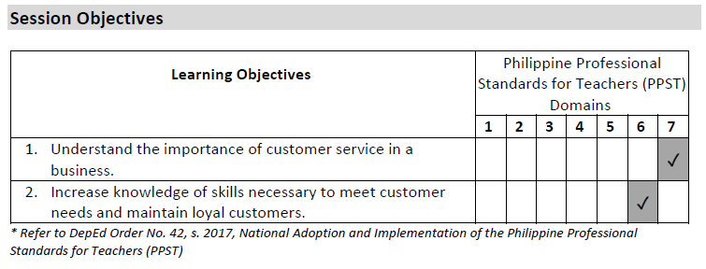
MODULE 2.A
OVERVIEW
COLLABORATIVE EXPERTISE SESSION (CES) GUIDE ON BE YOUR OWN BOSS

Slide 35
MODULE 2.A
OVERVIEW
Session Prerequisites
It is ideal that the CES members have already read or browsed relevant sections of the Be Your Own Boss Facilitator’s Guide before this CES, particularly:
Activity 1: Introduction to Customer Service
Handout 4.1: What Is Customer Service and Why Is It So Important?
Activity 2: Giving Exceptional Customer Service
Handout 4.2: Giving Exceptional Customer Service
Handout 4.5: Resolving Conflicts with Upset/Difficult Customers
Duration
The entire session requires approximately two (2) hours.
COLLABORATIVE EXPERTISE SESSION (CES) GUIDE ON BE YOUR OWN BOSS

Slide 36
MODULE 2.A
OVERVIEW
Preliminaries
[Total: 5 minutes]
Accomplish the Pre-CES Competency Assessment Checklist (Annex A).
Provide an overview of the CES.
Go through the session objectives.
COLLABORATIVE EXPERTISE SESSION (CES) GUIDE ON BE YOUR OWN BOSS

Slide 37
MODULE 2.A
OVERVIEW
Priming Activity
[Total: 10 minutes]
An activity entitled ROSE-THORN-BUD will follow. This activity will allow the CES facilitator to assess the participants’ knowledge about the topic of Customer Service and their readiness to participate in the upcoming session.
The CES facilitator will start by defining the meanings of the following:
  Rose – a highlight, success, small win, or anything positive that the participant has experienced related to customer service. Remember that customer service is how a business and its team meet the needs of the clients who use their products and/or services.
  Thorn – a challenge experienced by the participant or something that he/she thinks can be improved with better customer service.
  Bud – suggestions or ideas from the “thorn” that the participant can think of to improve customer experience.
COLLABORATIVE EXPERTISE SESSION (CES) GUIDE ON BE YOUR OWN BOSS

Slide 38
MODULE 2.A
OVERVIEW
The CES facilitator may give examples based on his/her own experience or use the ones below:
My rose: During a recent purchase from a fast-food restaurant, there was a note in the takeout bag saying, “Stay safe and dry.” (Note to CES facilitator: It may be emphasized that adding a personal touch to takeout items may encourage customers to come back, and this can be considered as a marketing strategy on top of excellent customer service.)
My thorn: There was a long line in a fast-food restaurant at around 2:30 pm, and when it was my turn, the cashier said that their best-selling fried chicken has been sold out since noon.
My bud: Based on my thorn example, there should be a sign in the fast-food restaurant stating that the chicken is already out of stock so that those who are queuing to buy the chicken can think of another order or leave in case they don’t have alternative orders.
For five minutes, instruct the CES members to quietly ponder on their past customer service experiences and identify their rose, bud, and thorn. The participants may note down their thoughts.
Call on at least two (2) participants (depending on the remaining time) to share their answers with the rest of the group.
COLLABORATIVE EXPERTISE SESSION (CES) GUIDE ON BE YOUR OWN BOSS

Slide 39
MODULE 2.A
OVERVIEW
Main Activity
[Total: 30 minutes]
Divide CES members into two (2) groups.
Allow 15 minutes to review Handouts 4.1 and 4.2, focusing on practical tips.
Encourage linking the content to their Rose-Thorn-Bud insights, if relevant.
Assign scenarios:
  Group 1: A salon client unhappy with their haircut despite clear instructions.
  Group 2: A buyer dissatisfied with a crochet bag due to design differences from online photos.
Give 10 minutes for groups to plan and practice their roleplay activity, emphasizing excellent customer service.
Have each group present their scenario for five (5) minutes.
COLLABORATIVE EXPERTISE SESSION (CES) GUIDE ON BE YOUR OWN BOSS

Slide 40
MODULE 2.A
OVERVIEW
Analysis
[Total: 15 minutes]
Ask the CES members the following questions:
What do you think about your group’s approach to handling the difficult customer? How about the other group’s strategy?
Why is excellent customer service important?
How does this knowledge help in planning and running a successful business?
COLLABORATIVE EXPERTISE SESSION (CES) GUIDE ON BE YOUR OWN BOSS

Slide 41
MODULE 2.A
OVERVIEW
Abstraction
[Total: 20 minutes]
Say: Now we know that there will be instances when a business owner or staff might encounter a difficult customer. Let us go through more tips given in Handout 4.5: Resolving Conflicts with Upset/Difficult Customers.
Discuss key points from Handout 4.5, connecting them to experiences from the Rose-Thorn-Bud activity.
Emphasize the value of excellent customer service and encourage remembering these tips for Module 2 implementation.
COLLABORATIVE EXPERTISE SESSION (CES) GUIDE ON BE YOUR OWN BOSS

Slide 42
MODULE 2.A
MODULE 1
Application
[Total: 25 minutes]
Ask the CES members to go back to the groupings from the previous activity.
Say: In the previous CES, we filled-out graphic organizers to help us map out key concepts that will be discussed with our ALS learners. We will do something similar today based on our latest learnings. Just like before, you have 10 minutes to fill out graphic organizers as a small group.
COLLABORATIVE EXPERTISE SESSION (CES) GUIDE ON BE YOUR OWN BOSS

Slide 43
MODULE 2.A
OVERVIEW
Ask the three groups to briefly share their filled out graphic organizers.
Say: Thank you for sharing your graphic organizers. Collaboration is valuable, but creating your own based on your learners’ needs is recommended. Feel free to take photos for reference. In the next CES, you’ll work in pairs or triads. This will be challenging at first, but you’ll adapt quickly.
COLLABORATIVE EXPERTISE SESSION (CES) GUIDE ON BE YOUR OWN BOSS

Slide 44
MODULE 2.A
OVERVIEW
Assessment Administration Tips
[Total: 10 minutes]
Have CES members complete the Session 3 Reflection Sheet and discuss some reflections as a group.
Plan how to guide learners in answering and processing the Reflection Sheet.
Remind learners there are no right or wrong answers; encourage honest responses to identify what matters most in customer service.
Provide written feedback highlighting their strengths and areas for improvement.
COLLABORATIVE EXPERTISE SESSION (CES) GUIDE ON BE YOUR OWN BOSS

Slide 45
MODULE 2.A
OVERVIEW
Closing
[Total: 5 minutes]
Review the session objectives together with the CES members. Validate if the objectives were met.
Administer the post-CES competency assessment (Annex B).
Identify the topic, prerequisites, and schedule for the next CES.
Thank the CES members and congratulate them for completing the CES.
Encourage them to ponder on the quote of Bill Gates below, relating it to the importance of effectively handling customer complaints: "Your most unhappy customers are your greatest source of learning."
COLLABORATIVE EXPERTISE SESSION (CES) GUIDE ON BE YOUR OWN BOSS

Slide 46
COLLABORATIVE EXPERTISE SESSION (CES) GUIDE ON
BE YOUR OWN BOSS
MODULE 2.B
MARKETING MY BUSINESS
This CES guide module complements portions of Session 4 and Session 5 in Module 2 of the Be Your Own Boss Facilitator’s Guide. It contains basic marketing concepts and practical exercises for creating a marketing plan.

Slide 47
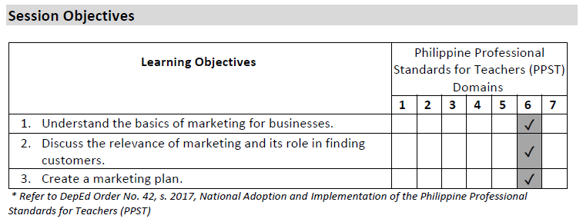
MODULE 2.B
OVERVIEW
COLLABORATIVE EXPERTISE SESSION (CES) GUIDE ON BE YOUR OWN BOSS

Slide 48
MODULE 2.B
OVERVIEW
Session Prerequisites
It is ideal that the CES members have already read or browsed relevant sections of the Be Your Own Boss Facilitator’s Guide prior to this CES, particularly:
Handout 5.0: Definition of Market and Marketing Concepts
Handout 5.1: The Marketing Elements Defined
Handout 5.2: The 6 Marketing Elements of My Favorite Business
Handout 5.3: Personal Assessment Worksheet
Duration
The entire session requires approximately two (2) hours.
COLLABORATIVE EXPERTISE SESSION (CES) GUIDE ON BE YOUR OWN BOSS

Slide 49
MODULE 2.B
OVERVIEW
Preliminaries
[Total: 5 minutes]
Accomplish the Pre-CES Competency Assessment Checklist (Annex A).
Provide an overview of the CES.
Go through the session objectives.
Priming Activity
[Total: 10 minutes]
Ask CES members to recall a memorable business advertisement (tagline, jingle, mascot, video, or print ad).
Have up to five (5) members briefly share examples where the ad convinced them to buy or use the product/service.
COLLABORATIVE EXPERTISE SESSION (CES) GUIDE ON BE YOUR OWN BOSS

Slide 50
MODULE 2.B
OVERVIEW
Main Activity
[Total: 25 minutes]
Review the Six Marketing Elements (6Ps) using Tool 5.1: The Marketing Mix from the Be Your Own Boss Facilitator’s Guide.
Divide the CES members into three (3) groups.
Allow 10 minutes for the groups to review these handouts:
  Handout 5.1: The Marketing Elements Defined
  Handout 5.2: The 6 Marketing Elements of My Favorite Business
  Handout 5.3: Personal Assessment Worksheet
Inform them they will apply the Six Marketing Elements in an exercise.
After 10 minutes of discussion and preparation, have groups complete the Marketing Plan Template for 15 minutes. This tool is based on the Six Marketing Elements, with additional questions for expansion.
COLLABORATIVE EXPERTISE SESSION (CES) GUIDE ON BE YOUR OWN BOSS

Slide 51
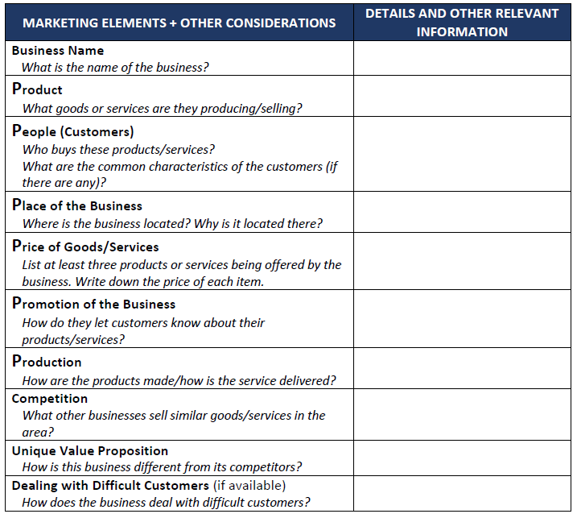
MODULE 2.B
OVERVIEW
They may choose to write about an existing business based on the themes or concepts below:
Bakeshop
Hair Salon
Online Clothing Store
Snacks Stall
Carinderia
Flower Shop
Vegetable/ Fruit Stand
Sari-sari Store
COLLABORATIVE EXPERTISE SESSION (CES) GUIDE ON BE YOUR OWN BOSS

Slide 52
MODULE 2.B
OVERVIEW
Analysis
[Total: 30 minutes]
Have a group representative present their Marketing Plan Template (7 minutes per group).
Synthesize their responses and remind them to keep their templates for future activities.
Discuss the following:
  What information is essential for creating an effective marketing plan?
  What challenges might ALS learners face when applying the 6Ps of Marketing or completing the Marketing Plan Template?
  What improvements could make the materials more effective?
COLLABORATIVE EXPERTISE SESSION (CES) GUIDE ON BE YOUR OWN BOSS

Slide 53
MODULE 2.B
OVERVIEW
Abstraction
[Total: 15 minutes]
Emphasize the importance of the 6Ps of Marketing in Activity 3: Doing Market Research (see Handout 5.4: What is Market Research?).
Reiterate that advertising is a key part of a business's marketing strategy and explain marketing concepts from Handout 5.0: Definition of Market and Marketing Concepts:
  Communicating a product’s value to customers to drive sales (relevant to advertisements). (Note to CES facilitator: Advertisements are more relevant to this definition compared to the second one.)
  Identifying and satisfying customer needs and wants through targeted efforts and processes.
COLLABORATIVE EXPERTISE SESSION (CES) GUIDE ON BE YOUR OWN BOSS

Slide 54
MODULE 2.B
MODULE 1
Application
[Total: 25 minutes]
Say: You already know the drill. Please form pairs or triads and fill out a graphic organizer based on what you have learned today. However, you will not be presenting your graphic organizers to the bigger group right away. There will be further instructions later, but for now you have 10 minutes to complete the graphic organizer.
COLLABORATIVE EXPERTISE SESSION (CES) GUIDE ON BE YOUR OWN BOSS

Slide 55
MODULE 2.B
OVERVIEW
After 10 minutes, have the pairs/triads exchange graphic organizers. Allow 10 minutes to review and note good practices or provide suggestions for improvement.
Once time is up, return the graphic organizers to their owners. Invite up to three (3) volunteers to share their output and any comments received. Highlight promising action steps or discuss interesting points, if time allows.
Say: Let us thank our volunteers for sharing their graphic organizers. It seems that your graphic organizers are becoming more comprehensive as we go along. (Note to the CES facilitator: You may include some more personalized feedback on the overall quality of the graphic organizers so far, if appropriate. Use the Sandwich Method.)
Say: Please keep up the good work and feel free to take photos of today’s graphic organizers. You may find them handy when making your own.
COLLABORATIVE EXPERTISE SESSION (CES) GUIDE ON BE YOUR OWN BOSS

Slide 56
MODULE 2.B
OVERVIEW
Assessment Administration Tips
[Total: 10 minutes]
Have CES members complete the Module 2 Post-Test to assess understanding, address common errors, and write personal reflections.
Plan how to guide learners in completing Reflection Sheets for Sessions 4, 5, and the End-of-Module Assessment.
For Session 4 Reflection Sheets, encourage learners to reflect on impactful consumer experiences to identify what matters most as a business owner.
For Session 5 Reflection Sheets, ask learners to note all ideas for business planning, even vague ones, as there will be opportunities to refine them later.
Use the End-of-Module Assessment answer key to process answers, focusing on common errors that may need extra attention.
Apply the Sandwich Method for constructive feedback.
COLLABORATIVE EXPERTISE SESSION (CES) GUIDE ON BE YOUR OWN BOSS

Slide 57
MODULE 2.B
OVERVIEW
Closing
[Total: 5 minutes]
Review the session objectives together with the CES members. Validate if the objectives were met.
Administer the post-CES competency assessment (Annex B).
Identify the topic, prerequisites, and schedule for the next CES.
Thank the CES members and congratulate them for completing the CES.
Remind the CES members to keep or take photos of the Marketing Plan Template they developed in this session as it may be used again in the future.
Encourage them to ponder over the reflection question below outside of the CES: “How can excellent customer service be offered by a budding, small-scale business?”
COLLABORATIVE EXPERTISE SESSION (CES) GUIDE ON BE YOUR OWN BOSS

Slide 58
COLLABORATIVE EXPERTISE SESSION (CES) GUIDE ON
BE YOUR OWN BOSS
MODULE 3
MANAGING MY BUSINESS AND PERSONAL FINANCE
This CES guide module complements Module 3 of the Be Your Own Boss Facilitator’s Guide. It tackles essential financial principles, including the separation of personal and business expenses, income, and profit.

Slide 59
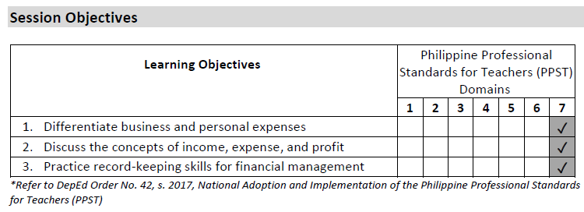
MODULE 3
OVERVIEW
COLLABORATIVE EXPERTISE SESSION (CES) GUIDE ON BE YOUR OWN BOSS

Slide 60
MODULE 3
OVERVIEW
Session Prerequisites
It is ideal that the CES members have already read or browsed relevant sections of the Be Your Own Boss Facilitator’s Guide prior to this CES, particularly:
Session 6 Information Sheet Pro Faci Tip
Activity 1: Separating Business and Personal Expenses
Handout 6.1: Separating Personal and Business Expenses
Handout 6.2: What Is Income?
Handout 6.5: What Are Expenses?
Handout 6.7: What Is Profit?
Activity 5: Record Keeping/Money In - Money Out - Basic Record
Handout 6.3: Instant-Shop Online Food Delivery Case Study
Handout 6.12: Money In/Money Out Template
Facilitator Tool 6.4: Instant-Shop Online Food Delivery Money In/Money Out Template
Duration
The entire session requires approximately two (2) hours.
COLLABORATIVE EXPERTISE SESSION (CES) GUIDE ON BE YOUR OWN BOSS

Slide 61
MODULE 3
OVERVIEW
Preliminaries
[Total: 5 minutes]
Accomplish the Pre-CES Competency Assessment Checklist (Annex A).
Provide an overview of the CES.
Go through the session objectives.
COLLABORATIVE EXPERTISE SESSION (CES) GUIDE ON BE YOUR OWN BOSS

Slide 62
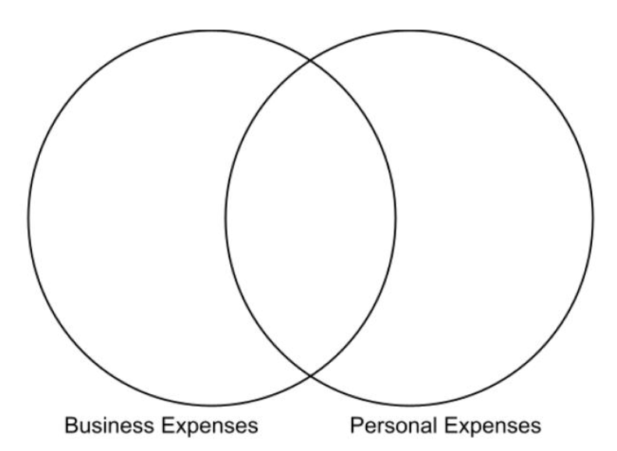
MODULE 3
OVERVIEW
Priming Activity
[Total: 15 minutes]
This activity serves as a quick tryout for Handout 6.1: Separating Personal and Business Expenses.
The CES members will be divided into three groups.
Each group will be given a sheet of paper with this Venn diagram (or they may draw the diagram by themselves):
COLLABORATIVE EXPERTISE SESSION (CES) GUIDE ON BE YOUR OWN BOSS

Slide 63
MODULE 3
OVERVIEW
The CES members will be given 5 minutes to go through the examples of expenses on Handout 6.1. and fill out the diagram based on where they think the expenses should be classified.
After 5 minutes, the groups will be asked to exchange worksheets.
The groups will check each other’s work as the CES facilitator processes the ideal answers. (Note to CES facilitator: Refer to Session 6 Information Sheet – Pro Faci Tip)
By the end of the activity, the CES members should have a general overview of the differences between personal and business expenses.
COLLABORATIVE EXPERTISE SESSION (CES) GUIDE ON BE YOUR OWN BOSS

Slide 64
MODULE 3
OVERVIEW
Main Activity
[Total: 40 minutes]
Using the same groupings, have the CES members discuss and process the following handouts for 10 minutes within their small groups:
  Handout 6.2: What Is Income?
  Handout 6.5: What Are Expenses?
  Handout 6.7: What Is Profit?
After 10 minutes, give the CES members placards with the words INCOME, BUSINESS EXPENSE, PERSONAL EXPENSE, and PROFIT.
Present scenarios using slides or read them aloud, and have participants raise placards to identify each as income, business expense, personal expense, or profit.
After each scenario, announce the correct answer and explain it briefly.
COLLABORATIVE EXPERTISE SESSION (CES) GUIDE ON BE YOUR OWN BOSS

Slide 65
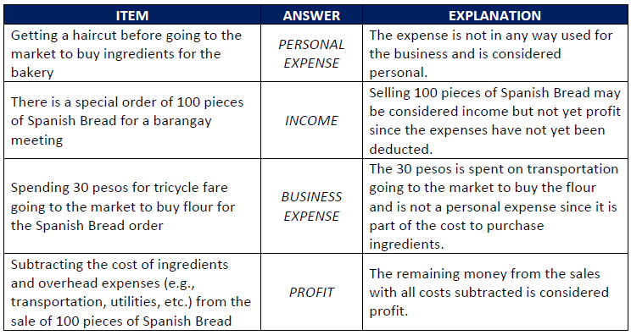
MODULE 3
OVERVIEW
Sample scenarios may be seen below:
COLLABORATIVE EXPERTISE SESSION (CES) GUIDE ON BE YOUR OWN BOSS

Slide 66
MODULE 3
OVERVIEW
Next, ask the CES members to go over Activity 5: Record Keeping/Money In - Money Out - Basic Record and Handout 6.3: Instant-Shop Online Food Delivery Case Study as a group (10 minutes).
Have them try out Handout 6.12: Money In/Money Out Template also as a group (10 minutes).
Afterwards, ask the groups to exchange worksheets with other groups. The groups will check each other’s work using Facilitator Tool 6.4: Instant-Shop Online Food Delivery Money In/Money Out Template.
Optional: CES members may further increase their knowledge of basic record-keeping skills by watching a sample YouTube video: https://www.youtube.com/watch?v=mUB25jcZUzI
COLLABORATIVE EXPERTISE SESSION (CES) GUIDE ON BE YOUR OWN BOSS

Slide 67
MODULE 3
OVERVIEW
Analysis
[Total: 15 minutes]
Ask the CES members the following questions:
Why is it important for entrepreneurs to distinguish between personal and business expenses? What are the consequences of not doing so?
Why must entrepreneurs understand the differences among income, profit, and expenses?
How was your experience tracking a business’s cash flow?
What challenges might ALS learners face when completing Module 3 worksheets?
COLLABORATIVE EXPERTISE SESSION (CES) GUIDE ON BE YOUR OWN BOSS

Slide 68
MODULE 3
OVERVIEW
Abstraction
[Total: 15 minutes]
Say: To reiterate, business owners need to separate personal expenses from business expenses to avoid misusing their funds. This also helps the owner maintain accountability for the money flowing in and out of the business. (Note to CES facilitator: This explanation is also used in Activity 1: Separating Business and Personal Expenses.)
Say: Moreover, the same principle applies to knowing the difference between profit, income, and expense. Being able to differentiate and track these accordingly are crucial to ensuring accuracy of the business cash flow records. (Note to CES facilitator: When discussing the concept of income, touch on its difference from profit. It might cause confusion because in Filipino “income” and “profit” are both “kita.” For more advice on deepening and contextualizing the sessions, have the CES members check out sections on Pro Faci Tips.)
COLLABORATIVE EXPERTISE SESSION (CES) GUIDE ON BE YOUR OWN BOSS

Slide 69
MODULE 3
OVERVIEW
The bigger group may process the previous activities further by discussing how the templates and experience of filling them out might be further contextualized for their learners.
Optional: Should the CES members express further interest in learning more about income, profit, and expenses, they may refer to Income Plus Different Types of Expense and Profit (Annex D).
COLLABORATIVE EXPERTISE SESSION (CES) GUIDE ON BE YOUR OWN BOSS

Slide 70
MODULE 3
MODULE 1
Application
[Total: 15 minutes]
Say: Like in the previous CES, please form pairs or triads. For 15 minutes, fill out your graphic organizers based on today’s discussions.
COLLABORATIVE EXPERTISE SESSION (CES) GUIDE ON BE YOUR OWN BOSS

Slide 71
MODULE 3
OVERVIEW
Have pairs/triads exchange graphic organizers and review them for five (5) minutes, noting good practices and offering suggestions for improvement.
After five (5) minutes, return the organizers to their owners. Invite up to three (3) volunteers to share their output and any comments, with a brief discussion if time permits.
Encourage CES members to take photos or notes of key takeaways to apply to their own organizers.
COLLABORATIVE EXPERTISE SESSION (CES) GUIDE ON BE YOUR OWN BOSS

Slide 72
MODULE 3
OVERVIEW
Assessment Administration Tips
[Total: 10 minutes]
Have CES members complete the Module 3 Post-Test, address common errors, and write personal reflections.
Plan how to guide learners in completing Reflection Sheets for Sessions 6, 7, 8, and the End-of-Module Assessment.
Encourage learners to provide concrete ideas in Reflection Sheets, as these can directly contribute to their business plans.
Use the answer key to process the End-of-Module Assessment and provide feedback using the Sandwich Method.
COLLABORATIVE EXPERTISE SESSION (CES) GUIDE ON BE YOUR OWN BOSS

Slide 73
MODULE 3
OVERVIEW
Closing
[Total: 5 minutes]
Review the session objectives together with the CES members. Validate if the objectives were met.
Administer the post-CES competency assessment (Annex B).
Identify the topic, prerequisites, and schedule for the next CES.
Thank the CES members and congratulate them for completing the CES.
Encourage them to ponder over the quote below regarding its relevance to future business owners: “Beware of little expenses. A small leak will sink a great ship.” – Benjamin Franklin
COLLABORATIVE EXPERTISE SESSION (CES) GUIDE ON BE YOUR OWN BOSS

Slide 74
COLLABORATIVE EXPERTISE SESSION (CES) GUIDE ON
BE YOUR OWN BOSS
MODULE 4.A
WRITING MY BUSINESS PLAN
This CES guide module complements Session 9 in Module 4 of the Be Your Own Boss Facilitator’s Guide. It focuses on the process of developing and reviewing a business plan.

Slide 75
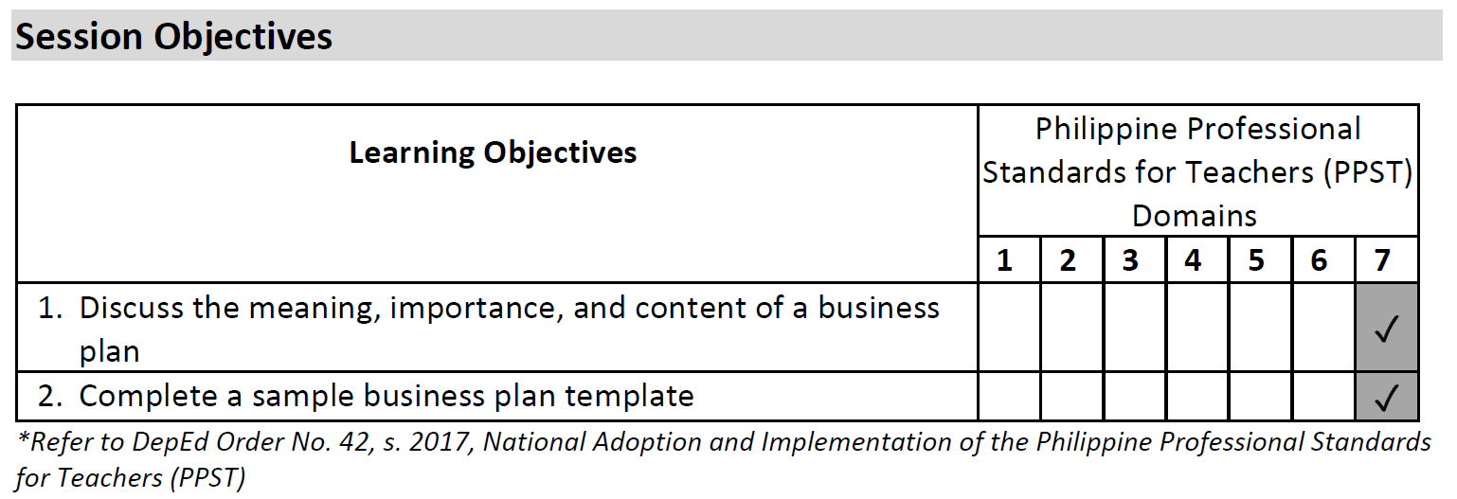
MODULE 4.A
OVERVIEW
COLLABORATIVE EXPERTISE SESSION (CES) GUIDE ON BE YOUR OWN BOSS

Slide 76
MODULE 4.A
OVERVIEW
Session Prerequisites
It is ideal that the CES members have already read or browsed relevant sections of the Facilitator’s Guide before this CES, particularly:
Handout 7.2: What is a Business Plan?
Handout 7.3: Components of a Business Plan
Handout 7.4: Sample Completed Business Plan
Handout 7.5: Business Plan Template
Handout 7.6 (a): Feedback Form for the Business Plan (English)
Handout 7.6 (b): Feedback Form for the Business Plan (Filipino)
Duration
The entire session requires approximately two (2) hours.
COLLABORATIVE EXPERTISE SESSION (CES) GUIDE ON BE YOUR OWN BOSS

Slide 77
MODULE 4.A
OVERVIEW
Preliminaries
[Total: 5 minutes]
Accomplish the Pre-CES Competency Assessment Checklist (Annex A).
Provide an overview of the CES.
Go through the session objectives.
COLLABORATIVE EXPERTISE SESSION (CES) GUIDE ON BE YOUR OWN BOSS

Slide 78
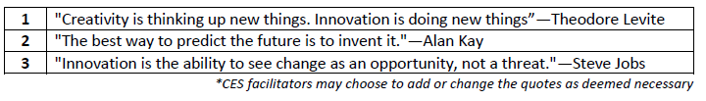
MODULE 4.A
OVERVIEW
Priming Activity
[Total: 15 minutes]
Divide the participants into three (3) groups.
Ask each group to draw ballots with numbers 1-3.
Each ballot corresponds to a quote in the following list:
Give the groups five (5) minutes to process their assigned quote and contextualize it in terms of how creativity and innovation can spark the creation of businesses. It would be better if they give examples of innovative businesses/business practices to further strengthen their point.
Give each group three (3) minutes to share the summary of their discussion.
COLLABORATIVE EXPERTISE SESSION (CES) GUIDE ON BE YOUR OWN BOSS

Slide 79
MODULE 4.A
OVERVIEW
Main Activity
[Total: 40 minutes]
Allow CES members 10 minutes to review Activity 1: Introduction to the Business Plan and Activity 2: Writing the Business Plan.
Have members individually complete Handout 7.5: Business Plan Template for 10 minutes, using previous marketing plans or new ideas, providing 1-2 examples per item, and referring to Handout 7.4: Sample Completed Business Plan for guidance.
Ask members to pair up and exchange business plans for review.
Give them five (5) minutes to review their partner’s plan using Handout 7.6 (a or b): Feedback Form. Option: Refer to the SCAMPER tool for recommendations.
Return plans to the original owners for five (5) minutes of review or revision.
  Option: Use the SCAMPER tool to improve the plans.
Invite 1-2 members to present their revised plans and share their experiences.
  Option: Organize a market encounter in the community to test their ideas, documenting lessons for refining their plans.
COLLABORATIVE EXPERTISE SESSION (CES) GUIDE ON BE YOUR OWN BOSS

Slide 80
MODULE 4.A
OVERVIEW
Analysis
[Total: 15 minutes]
Ask the CES members the following questions:
Why is a business plan important for turning creative ideas into action?
What key elements should a business plan include?
What risks might an aspiring entrepreneur face without a quality business plan?
COLLABORATIVE EXPERTISE SESSION (CES) GUIDE ON BE YOUR OWN BOSS

Slide 81
MODULE 4.A
OVERVIEW
Abstraction
[Total: 15 minutes]
Say: In the priming activity, we had an idea of how businesses may be initiated through creative and innovative ideas. Various people may have different reasons for building their businesses. However, every business should have a business plan, and you were able to try that out in the second activity.
Reiterate the importance of a business plan for entrepreneurship and encourage CES members to anticipate potential challenges ALS learners may face when creating their plans to prepare effectively as facilitators.
COLLABORATIVE EXPERTISE SESSION (CES) GUIDE ON BE YOUR OWN BOSS

Slide 82
MODULE 4.A
MODULE 1
Application
[Total: 20 minutes]
Say: In the previous sessions, you have tried filling out graphic organizers by group, pairs, or triads. Now, it is time for you to try it out on your own. You have ten minutes to fill out your individual graphic organizers. Have fun!
COLLABORATIVE EXPERTISE SESSION (CES) GUIDE ON BE YOUR OWN BOSS

Slide 83
MODULE 4.A
OVERVIEW
After 10 minutes, have CES members exchange graphic organizers with their seatmates and review them, noting good practices and offering suggestions.
Once time is up, return the organizers to their owners. Invite up to two (2) volunteers to share their output and any feedback received, with a brief discussion if time allows.
Encourage members to take photos or notes of key takeaways for use in their own organizers.
COLLABORATIVE EXPERTISE SESSION (CES) GUIDE ON BE YOUR OWN BOSS

Slide 84
MODULE 4.A
OVERVIEW
Assessment Administration Tips
[Total: 5 minutes]
Have CES members complete the Session 3 Reflection Sheet and share some insights as a group.
Plan how to guide learners in completing the Session 9 Reflection Sheet.
Explain that Session 9 requires learners to think like investors. Guide them on the role of investors and what they seek in a business investment.
COLLABORATIVE EXPERTISE SESSION (CES) GUIDE ON BE YOUR OWN BOSS

Slide 85
MODULE 4.A
OVERVIEW
Closing
[Total: 5 minutes]
Review the session objectives together with the CES members. Validate if the objectives were met.
Administer the post-CES competency assessment (Annex B).
Identify the topic, prerequisites, and schedule for the last CES.
Ask them to bring copies of their business plans for the last CES.
Thank the CES members and congratulate them for completing the CES.
COLLABORATIVE EXPERTISE SESSION (CES) GUIDE ON BE YOUR OWN BOSS

Slide 86
COLLABORATIVE EXPERTISE SESSION (CES) GUIDE ON
BE YOUR OWN BOSS
MODULE 4.B
PRESENTING MY BUSINESS PLAN
This CES guide module complements Session 10 in Module 4 of the Be Your Own Boss Facilitator’s Guide. It provides tips on creating a business pitch and sharing business ideas with key stakeholders.

Slide 87
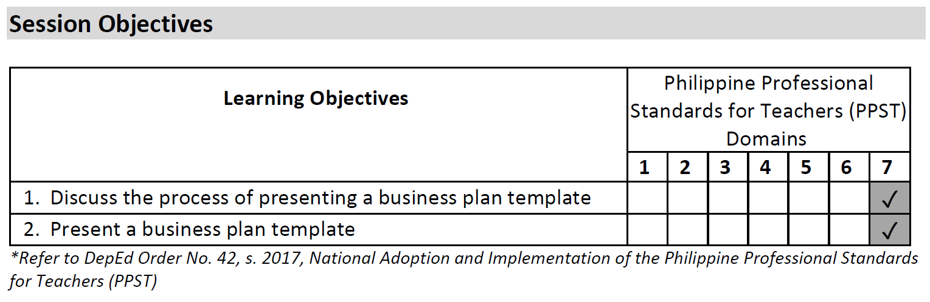
MODULE 4.B
OVERVIEW
COLLABORATIVE EXPERTISE SESSION (CES) GUIDE ON BE YOUR OWN BOSS

Slide 88
MODULE 4.B
OVERVIEW
Session Prerequisites
It is ideal that the CES members have already read or browsed relevant sections of the Facilitator’s Guide before this CES, particularly:
Handout 7.7: Tips for Presenting a Business Plan
Handout 7.8: Suggestions to Overcome Potential Barriers
Duration
The entire session requires approximately two (2) hours.
COLLABORATIVE EXPERTISE SESSION (CES) GUIDE ON BE YOUR OWN BOSS

Slide 89
MODULE 4.B
OVERVIEW
Preliminaries
[Total: 5 minutes]
Accomplish the Pre-CES Competency Assessment Checklist (Annex A).
Provide an overview of the CES.
Go through the session objectives.
Priming Activity
[Total: 10 minutes]
Ask CES members to recall a recent experience where effective "sales talk" (colloquial term: budol) convinced them to purchase a product or service.
Invite 2-3 members to share what made the "sales talk" persuasive.
Explain that in the next session, they will create their own "sales talk" using the business plan from the previous session.
COLLABORATIVE EXPERTISE SESSION (CES) GUIDE ON BE YOUR OWN BOSS

Slide 90
MODULE 4.B
OVERVIEW
Main Activity
[Total: 45 minutes]
Inform CES members that they will draft individual business presentations as elevator pitches—short, impactful messages designed to be shared within the duration of an elevator ride.
  (Note to CES facilitator: This may also be called a “tricycle pitch” if that is more relatable).
COLLABORATIVE EXPERTISE SESSION (CES) GUIDE ON BE YOUR OWN BOSS

Slide 91
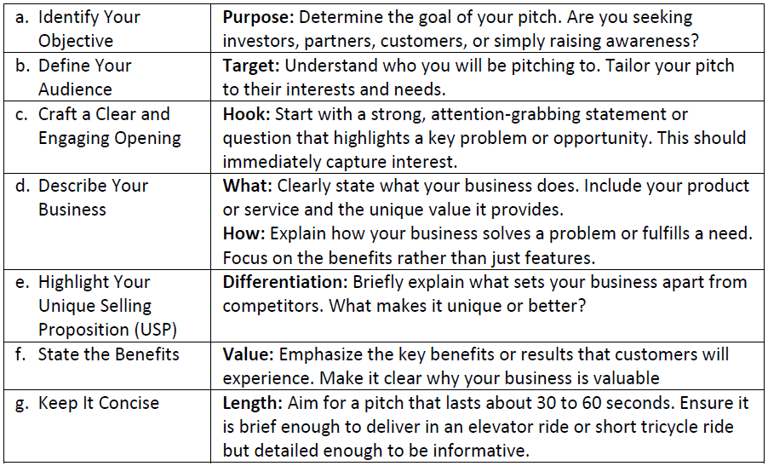
MODULE 4.B
OVERVIEW
Outline the basic steps in creating an elevator pitch.
COLLABORATIVE EXPERTISE SESSION (CES) GUIDE ON BE YOUR OWN BOSS

Slide 92
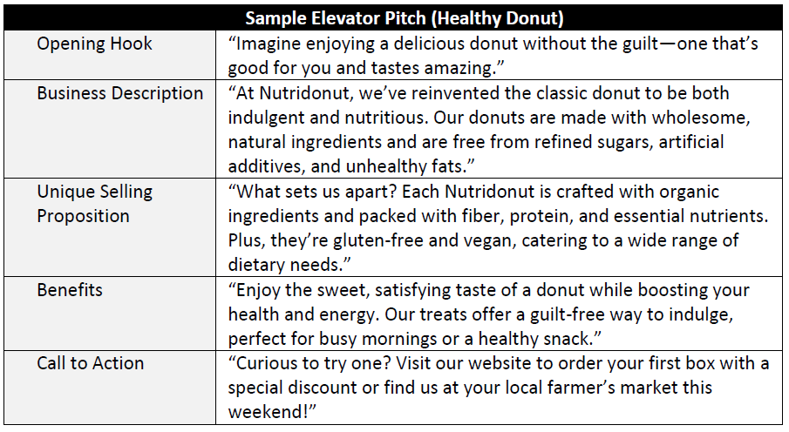
MODULE 4.B
OVERVIEW
Present the sample elevator pitch about the fictional brand “Nutridonut.”
COLLABORATIVE EXPERTISE SESSION (CES) GUIDE ON BE YOUR OWN BOSS

Slide 93
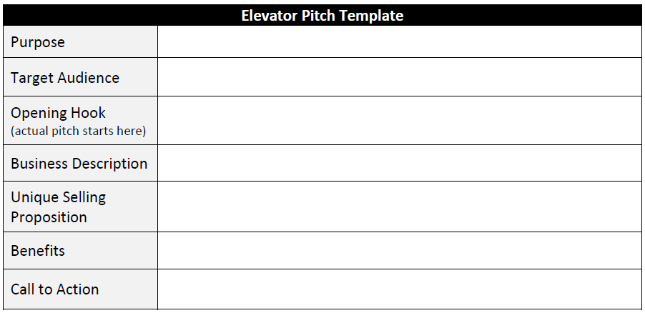
MODULE 4.B
OVERVIEW
Allot five (5) minutes for clarifications before letting the members write their own elevator pitches.
Ask the CES members to bring out the individual business plans they made in the previous CES.
Give them 10 minutes to prepare a 1-minute elevator pitch for their business using the template below.
COLLABORATIVE EXPERTISE SESSION (CES) GUIDE ON BE YOUR OWN BOSS

Slide 94
MODULE 4.B
OVERVIEW
Afterwards, ask the CES members to choose a partner to practice elevator pitches with. The partner may give feedback immediately after the pitch, and then they switch roles.
Let the CES members improve their individual elevator pitches for five (5) more minutes.
Ask 2-3 volunteers to do their elevator pitches for the bigger group.
Optional: Should the CES members seek tips in expanding one’s connections to enrich the ALS learners’ experiences, they may check out Networking and Building Partnerships (Annex F).
COLLABORATIVE EXPERTISE SESSION (CES) GUIDE ON BE YOUR OWN BOSS

Slide 95
MODULE 4.B
OVERVIEW
Analysis
[Total: 10 minutes]
Ask the CES members the following questions:
How was your experience writing and presenting your business pitch? How can an effective pitch help grow your business?
What challenges might ALS learners face when creating their business pitch, and how can they overcome them?
COLLABORATIVE EXPERTISE SESSION (CES) GUIDE ON BE YOUR OWN BOSS

Slide 96
MODULE 4.B
OVERVIEW
Abstraction
[Total: 15 minutes]
As a group, review Handout 7.7: Tips for Presenting a Business Plan and Handout 7.8: Suggestions to Overcome Potential Barriers.
Discuss the volunteers’ presentations, focusing on best practices, areas for improvement, and effectiveness, using the Sandwich Method for feedback.
  Optional: Create a simple award for the best pitch(es).
COLLABORATIVE EXPERTISE SESSION (CES) GUIDE ON BE YOUR OWN BOSS

Slide 97
MODULE 4.B
MODULE 1
Application
[Total: 20 minutes]
Say: We now proceed to the final graphic organizer. You have 10 minutes to fill out your individual graphic organizers.
COLLABORATIVE EXPERTISE SESSION (CES) GUIDE ON BE YOUR OWN BOSS

Slide 98
MODULE 4.B
OVERVIEW
After 10 minutes, have CES members exchange graphic organizers with their seatmates and review them for five (5) minutes, noting good practices and providing suggestions.
Once time is up, return the organizers to their owners. Invite up to three volunteers to share their output and any feedback received, with a brief discussion if time allows.
Encourage members to take photos or notes of key takeaways to apply to their own organizers.
Say: It is good to see how much you as CES members and Be Your Own Boss facilitators have learned in the past sessions.
  (Note to the CES facilitator: You may include some more personalized feedback on the overall quality of the graphic organizers so far, if appropriate. Use the Sandwich Method.)
Say: I hope that these notes will be helpful to you as you facilitate your sessions with the ALS learners.
COLLABORATIVE EXPERTISE SESSION (CES) GUIDE ON BE YOUR OWN BOSS

Slide 99
MODULE 4.B
OVERVIEW
Assessment Administration Tips
[Total: 10 minutes]
Have CES members complete the Module 4 Post-Test, address common errors and misunderstanding, and write personal reflections.
Plan how to guide learners in completing the End-of-Module Assessment, Handout 8.1: Learner End of Course Evaluation Form, Session 10 Reflection Sheet, and the Be Your Own Boss Post-Test.
Use the answer key to process the End-of-Module Assessment, addressing common errors.
COLLABORATIVE EXPERTISE SESSION (CES) GUIDE ON BE YOUR OWN BOSS

Slide 100
MODULE 4.B
OVERVIEW
Encourage learners to give honest feedback in Handout 8.1 to improve Be Your Own Boss activities for future learners.
Use the Session 10 Reflection Sheet to help learners process their business presentation experiences, offering contextualized support based on their needs. Some may find it fun and exhilarating, while some may find it nerve-wracking. As the facilitator, try to provide support that is contextualized to their unique and individual needs.
Emphasize that the Be Your Own Boss Post-Test is ungraded and highlights their growth. Use the answer key for checking and motivate them to continue learning independently.
COLLABORATIVE EXPERTISE SESSION (CES) GUIDE ON BE YOUR OWN BOSS

Slide 101
MODULE 4.B
OVERVIEW
Closing
[Total: 5 minutes]
Review the session objectives together with the CES members. Validate if the objectives were met.
Administer the Post-CES competency assessment (Annex B).
Thank the CES members and congratulate them for completing all the CES.
Encourage them to continuously find ways to further enrich their knowledge of entrepreneurship and business planning at their own convenience (e.g., exploring Annex C to Annex E).
COLLABORATIVE EXPERTISE SESSION (CES) GUIDE ON BE YOUR OWN BOSS

