Slide 1

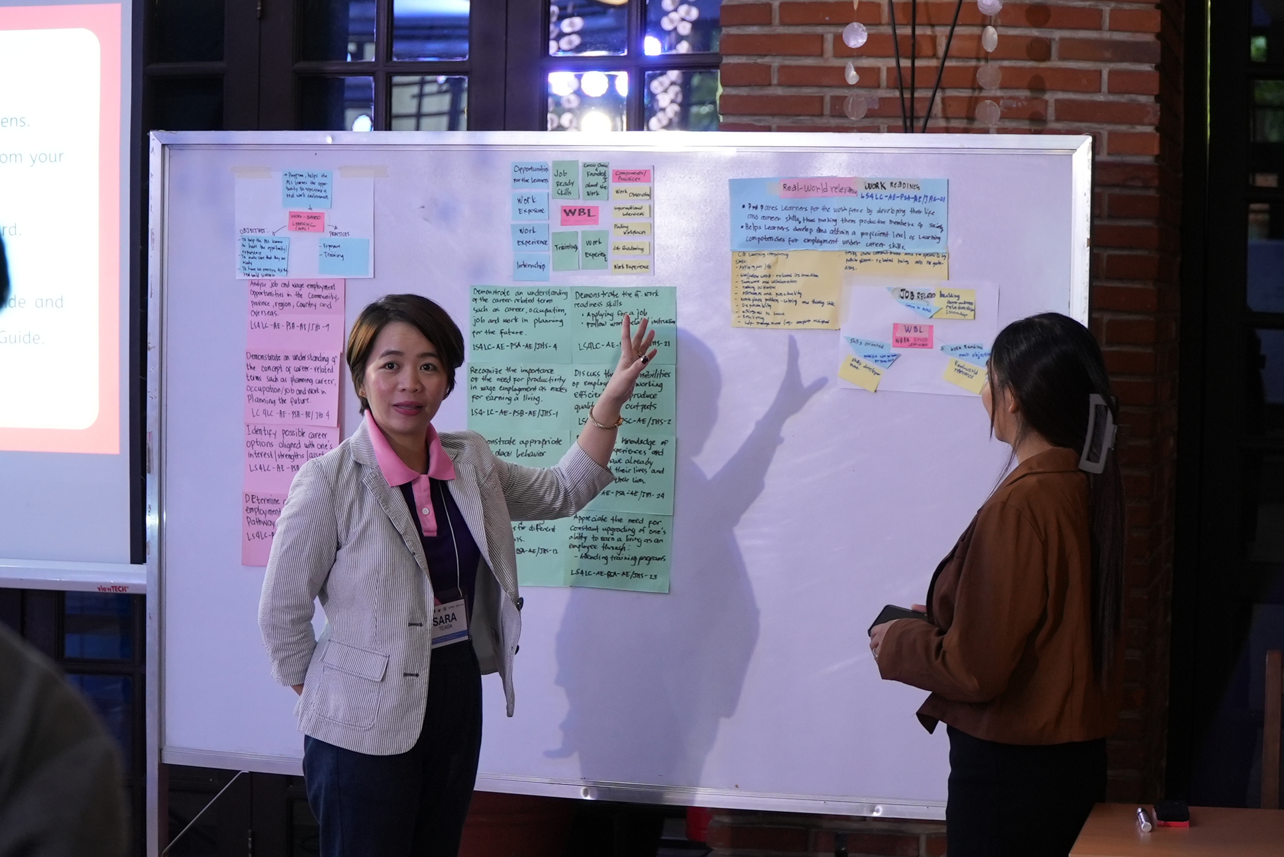

COLLABORATIVE EXPERTISE SESSION (CES) GUIDE ON
Work-Based Learning
FOR THE DEPARTMENT OF EDUCATION
ALTERNATIVE LEARNING SYSTEM

Slide 2

PRESENTATION FLOW
Purpose of the CES Guide
Parts of the CES guide
Structure of the CES Guides – 4 A’s of Adult Learning
  *Each module starts with the pre- and end with the post-assessment competency checklist.
COLLABORATIVE EXPERTISE SESSION (CES) GUIDE ON WORK-BASED LEARNING

Slide 3
1. PURPOSE OF THE CES GUIDE
Developed in partnership with the DepEd Bureau of Alternative Education (BAE) and funded by USAID's Opportunity 2.0 Program, this CES guide serves as a resource for ALS teachers. It aids in teaching and supporting learners to achieve employment and livelihood goals.
It emphasizes employment readiness competencies, rooted in the Work-Based Learning materials developed by the Education Development Center, Inc. as a global resource.
Aligned with the DepEd ALS Curriculum, particularly Learning Strand 4 on Life and Career Skills, Work-Based Learning allows learners to go through a series of experiential learning. Through these activities, learners gain life and work readiness skills preparing them for real-world employment opportunities.
COLLABORATIVE EXPERTISE SESSION (CES) GUIDE ON WORK-BASED LEARNING

Slide 4
1. PURPOSE OF THE CES GUIDE
Content of the guide is largely drawn from the WRN! Workplace: Work-Based Learning Facilitator’s Guide and Learner Handbook.
*The CES guide DOES NOT intend to replicate the Work-Based Learning Facilitator’s Guidebook. It aims to help the implementers use the Work-Based Learning Facilitator’s Guidebook with more ease and address some feedback and recommendations relevant to the implementation of the Work-Based Learning activities.
COLLABORATIVE EXPERTISE SESSION (CES) GUIDE ON WORK-BASED LEARNING

Slide 5
1. PURPOSE OF THE CES GUIDE
Adheres to the Philippine Professional Standards for Teachers (PPST)
  mastery of content knowledge
  creation of safe, secure, and supportive learning environments
  nurturing learner diversity
  use of relevant, collaborative teaching processes and resources
  use of authentic assessment processes and tools
  collaborative engagements
  personal and professional growth
COLLABORATIVE EXPERTISE SESSION (CES) GUIDE ON WORK-BASED LEARNING

Slide 6
2. PARTS OF THE CES GUIDE
The CES guide consists of the following parts:
  Overview of Work-Based Learning: Explains the rationale behind Work-Based Learning activities and their alignment with DepEd ALS Curriculum, particularly Learning Strand 4 on Life and Career Skills.
  Module 1: Introduction to Work-Based Learning: Highlights the work-based learning continuum and its role in exposing learners to real workplaces and activities to build credentials and track records.
  Module 2: Work Exposure: Expands on identifying “workplaces” within the community and provides practical tips for conducting work observation.
COLLABORATIVE EXPERTISE SESSION (CES) GUIDE ON WORK-BASED LEARNING

Slide 7
2. PARTS OF THE CES GUIDE
  Module 3: Preparing for a Longer Time in the Workplace: Covers job search tips, essential behaviors, and resources to ensure success and workplace safety.
  Module 4: Documenting Work Experience: Focuses on documenting and evaluating learners’ work experiences.
  Module 5: Forward Planning: Discusses support for learners and potential next steps after completing Work-Based Learning activities.
COLLABORATIVE EXPERTISE SESSION (CES) GUIDE ON WORK-BASED LEARNING

Slide 8
3. STRUCTURE OF THE CES GUIDE
Each part follows the 4As of learning:
  Activity: Engages participants by focusing on key concepts and skills related to the Work-Based Learning materials.
  Analysis: Makes learning meaningful by connecting new information with participants’ existing knowledge.
  Abstraction: Promotes active involvement through hands-on activities, discussions, and collaboration for deeper understanding and retention.
  Application: Develops practical skills, mastery, and the ability to implement Work-Based Learning activities and assessments.
    Assessment Administration Tips are also included to provide suggestions to CES members on how to roll out the assessments and reflections found in the Work-Based Learning Facilitator's Guide. Moreover, each module starts with the pre- and end with the post-assessment competency checklist.
COLLABORATIVE EXPERTISE SESSION (CES) GUIDE ON WORK-BASED LEARNING

Slide 9
COLLABORATIVE EXPERTISE SESSION (CES) GUIDE ON
WORK-BASED LEARNING
OVERVIEW

Slide 10
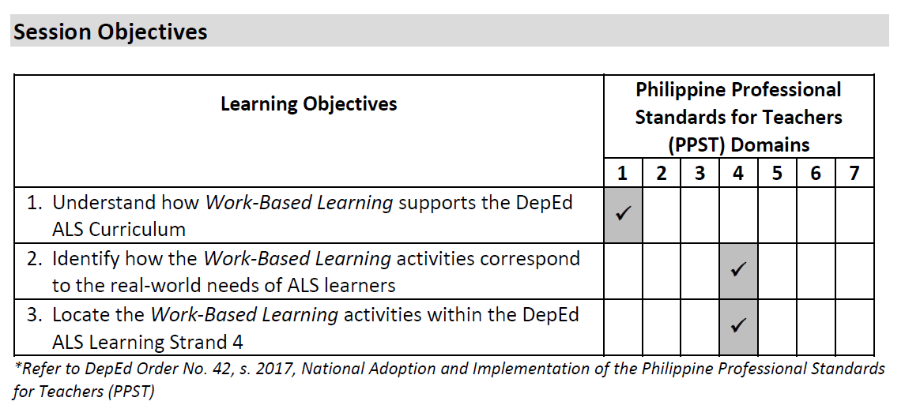
OVERVIEW
COLLABORATIVE EXPERTISE SESSION (CES) GUIDE ON WORK-BASED LEARNING

Slide 11
OVERVIEW
OVERVIEW
Session Prerequisites
This CES does not require any prerequisite knowledge and skills, but it would facilitate the learning session if the CES members are familiar with the DepEd ALS Learning Strand 4 competencies related to wage employment.
Duration
The entire session requires two (2) hours.
COLLABORATIVE EXPERTISE SESSION (CES) GUIDE ON WORK-BASED LEARNING

Slide 12
OVERVIEW
OVERVIEW
OVERVIEW
Preliminaries
[Total: 5 minutes]
Welcome the CES members and introduce yourself as the CES leader and/or facilitator. Introduce the rest of the CES, including the facilitator (if applicable), documenter, and members.
Accomplish the Pre-CES Competency Assessment Checklist (Annex A).
Provide an overview of the CES.
Go through the session objectives.
COLLABORATIVE EXPERTISE SESSION (CES) GUIDE ON WORK-BASED LEARNING

Slide 13
OVERVIEW
Activity
[Total: 30 minutes]
This session will utilize a mind-mapping activity to understand how Work-Based Learning supports the delivery of the DepEd ALS Learning Strand 4.
The mind-mapping activity can be done online using digital tools such as ClickUp, Miro, and Creately, among others.
Mind map using ClickUp
COLLABORATIVE EXPERTISE SESSION (CES) GUIDE ON WORK-BASED LEARNING

Slide 14
OVERVIEW
Alternatively, the mind-mapping activity can be done using a whiteboard, blackboard, or flipchart and marker pens.
Divide the CES members into smaller groups. Ideally, each group should have a maximum of five (5) members to encourage a meaningful discussion.
Provide each group with mind-mapping materials, e.g., an online tool or a whiteboard with marker pens.
Provide the following prompts in creating the mind-map (each group will do the same mind-map activity for 15 minutes):
  Place “Work-Based Learning” as the central node or idea.
  Add subsequent branches stemming from the central idea reflecting on the following questions:
    - What comes to mind right away when you hear “Work-Based Learning”?
    - What do you think is its main objective/s?
    - What are possible components or practices that contribute to achieving the objective/s?
Ask each group to present their output (3-5 minutes per group).
COLLABORATIVE EXPERTISE SESSION (CES) GUIDE ON WORK-BASED LEARNING

Slide 15
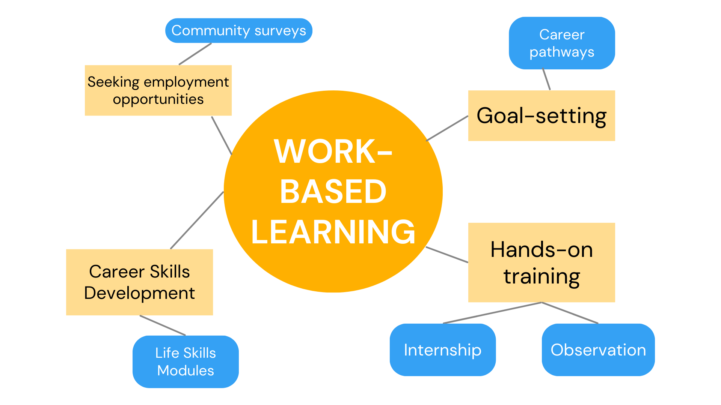
OVERVIEW
Sample mind-map
COLLABORATIVE EXPERTISE SESSION (CES) GUIDE ON WORK-BASED LEARNING

Slide 16
OVERVIEW
OVERVIEW
Analysis
[Total: 20 minutes]
Discuss the following with the CES members:
What common concepts surround Work-Based Learning, as we have seen in the mind maps?
What specific ideas in the mind map directly contribute to developing a job-ready ALS learner?
How does the concept of Work-Based Learning relate to the competencies of Learning Strand 4 on Life and Career Skills in the DepEd ALS Junior High School Curriculum?
COLLABORATIVE EXPERTISE SESSION (CES) GUIDE ON WORK-BASED LEARNING

Slide 17
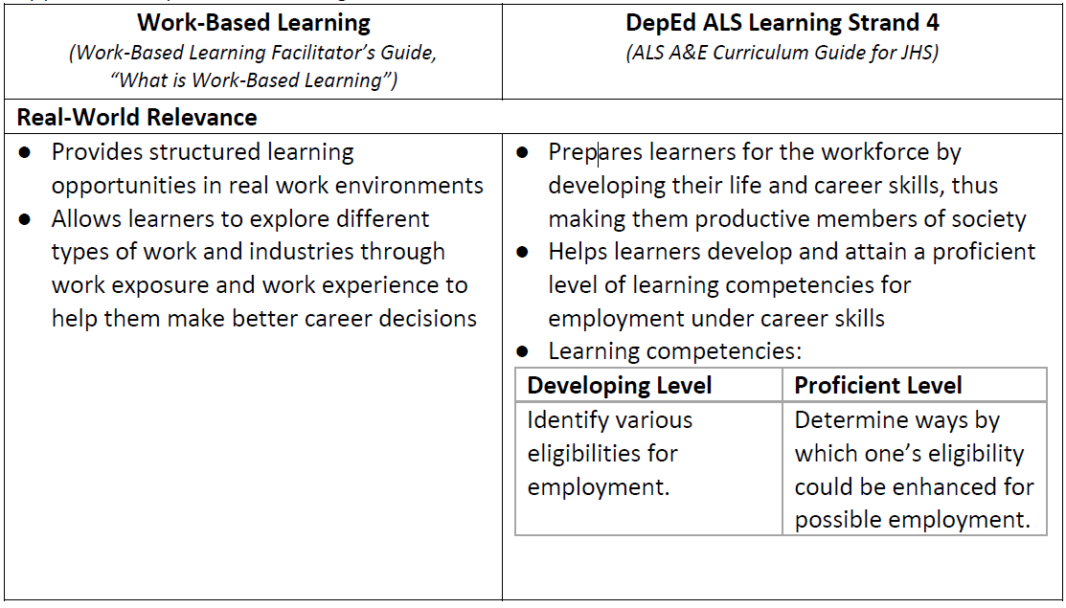

OVERVIEW
Abstraction
[Total: 30 minutes]
Building on the group output, explain the key features of Work-Based Learning and how they support the DepEd ALS Learning Strand 4.
COLLABORATIVE EXPERTISE SESSION (CES) GUIDE ON WORK-BASED LEARNING

Slide 18
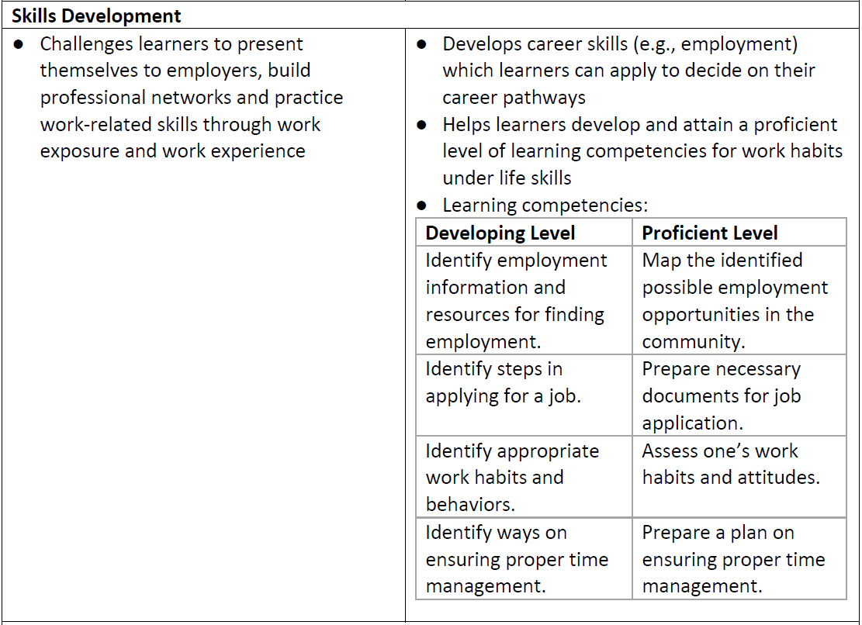
OVERVIEW
COLLABORATIVE EXPERTISE SESSION (CES) GUIDE ON WORK-BASED LEARNING

Slide 19
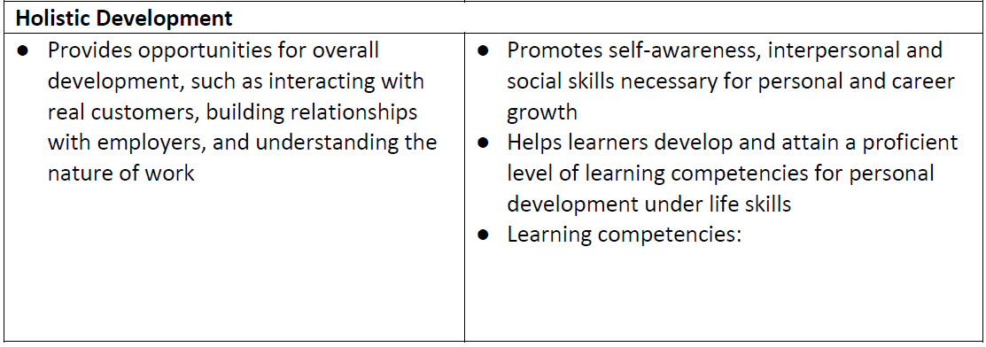
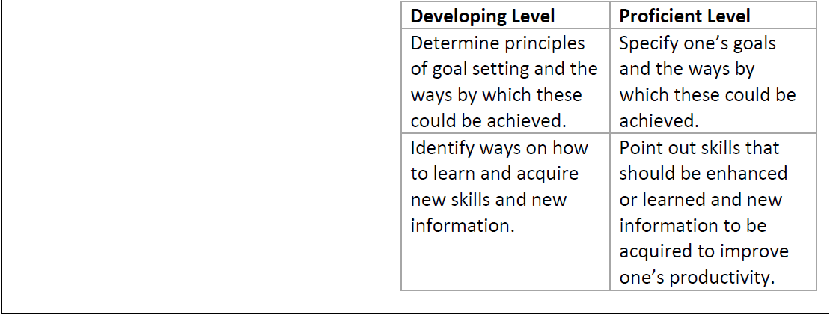
OVERVIEW
COLLABORATIVE EXPERTISE SESSION (CES) GUIDE ON WORK-BASED LEARNING

Slide 20
OVERVIEW
Application
[Total: 30 minutes]
Distribute meta cards and markers to each group.
Have groups identify learning competencies from their mind-maps that align with ALS Learning Strand 4 (20 minutes).
Have groups write each competency on a meta card.
Ask CES members to post the meta cards on a wall or board.
Synthesize the responses by linking them to the tagged competencies in the Work-Based Learning Facilitator’s Guide (10 minutes). Note that not all tagged competencies may surface during the CES. Assure members that this is expected and that they will get more familiar with other competencies as they go throughout the sessions.

Slide 21
OVERVIEW
Closing
[Total: 5 minutes]
Review the session objectives together with the CES members. Validate if the objectives were met.
Administer the Post-CES Competency Assessment Checklist (Annex B).
As may be necessary, identify the topic and schedule for the next CES.
Thank the CES members and congratulate them for completing the CES.
COLLABORATIVE EXPERTISE SESSION (CES) GUIDE ON WORK-BASED LEARNING

Slide 22
COLLABORATIVE EXPERTISE SESSION (CES) GUIDE ON
WORK-BASED LEARNING
MODULE 1
INTRODUCTION TO WORK-BASED LEARNING
This CES module complements Module 1 of the Work-Based Learning Facilitator’s Guide, emphasizing the Work-Based Learning continuum and its role in exposing learners to real workplaces to build credentials and track records.

Slide 23
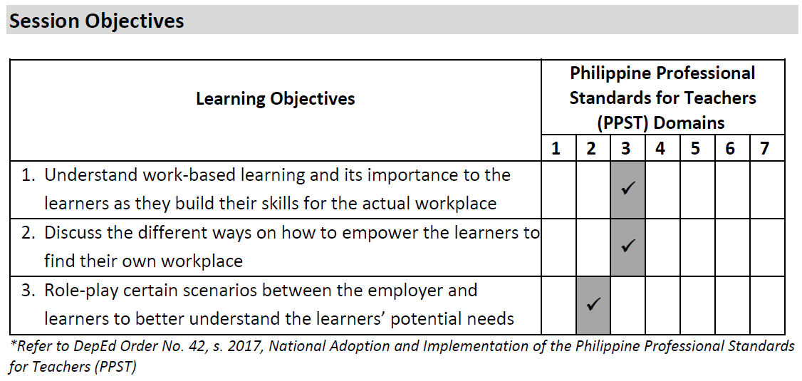
MODULE 1
MODULE 1
COLLABORATIVE EXPERTISE SESSION (CES) GUIDE ON WORK-BASED LEARNING

Slide 24
MODULE 1
MODULE 1
Session Prerequisites
It is ideal that the CES members have already read or browsed relevant sections of the Facilitator’s Guide prior to this CES, particularly:
  Notes to the Facilitator
  Activity 1: Introductory Activities
  Learner Handout 1: Work-Based Learning Continuum
  Activity 2: Goals and Structure of the DepEd ALS Work-Based Learning Sessions
  Activity 3: Using Work-Based Learning to Achieve Your Goals
  Activity 4: Involving Family in Work-Based Learning
Duration
The entire session requires approximately two (2) hours.
However, it may require additional 15-20 minutes to go through all or some of the expanded ideas in each session. These tips may, however, be given as self-directed learning materials to the CES members.
COLLABORATIVE EXPERTISE SESSION (CES) GUIDE ON WORK-BASED LEARNING

Slide 25
MODULE 1
MODULE 1
Preliminaries
[Total: 5 minutes]
  Accomplish the Pre-CES Competency Assessment Checklist (Annex A).
  Provide an overview of the CES.
  Go through the session objectives.
Priming Activity
[Total: 10 minutes]
  Ask the CES members to form four (4) groups.
  Encourage them to recall their very first job and think of any advice that they could give their younger selves who were trying to land their first job (5 minutes).
  Have them share those pieces of advice with the small group (5 minutes). Note that they will stay with the same group throughout the session.
COLLABORATIVE EXPERTISE SESSION (CES) GUIDE ON WORK-BASED LEARNING

Slide 26
MODULE 1
MODULE 1
Main Activity
[Total: 20 minutes]
Next, assign the following Module 1 activities to each of the four groups.
  Activity 1: Introductory Activities
  Activity 2: Goals and Structure of the DepEd ALS Work-Based Learning Sessions
  Activity 3: Using Work-Based Learning to Achieve Your Goals
  Activity 4: Involving Family in Work-Based Learning
Give the CES members 10 minutes to go through their assigned activity, paying close attention to the activity objectives, steps, and provided tools.
COLLABORATIVE EXPERTISE SESSION (CES) GUIDE ON WORK-BASED LEARNING

Slide 27
MODULE 1
MODULE 1
Analysis
[Total: 20 minutes]
Have each group summarize and present key points of their activity (3 minutes per group).
Discuss:
  How do the activity objectives support learners' work readiness?
  Are the steps sufficient to achieve the objectives? If not, what modifications could enhance or contextualize them?
What additional considerations are needed when teaching Work-Based Learning Module 1?
COLLABORATIVE EXPERTISE SESSION (CES) GUIDE ON WORK-BASED LEARNING

Slide 28
MODULE 1
MODULE 1
Abstraction
[Total: 30 minutes]
Say: To better prepare for the delivery of Work-Based Learning Module 1, let us go through some suggested tips that you may find helpful during the process.
Introducing the concept of work-based learning and the Work-Based Learning activities
Say: The Work-Based Learning Continuum (see following below) provides a visual representation of how learners can acquire work readiness skills through a series of learning experiences. Work-Based Learning activities focus on work exposure and work experience.
COLLABORATIVE EXPERTISE SESSION (CES) GUIDE ON WORK-BASED LEARNING

Slide 29
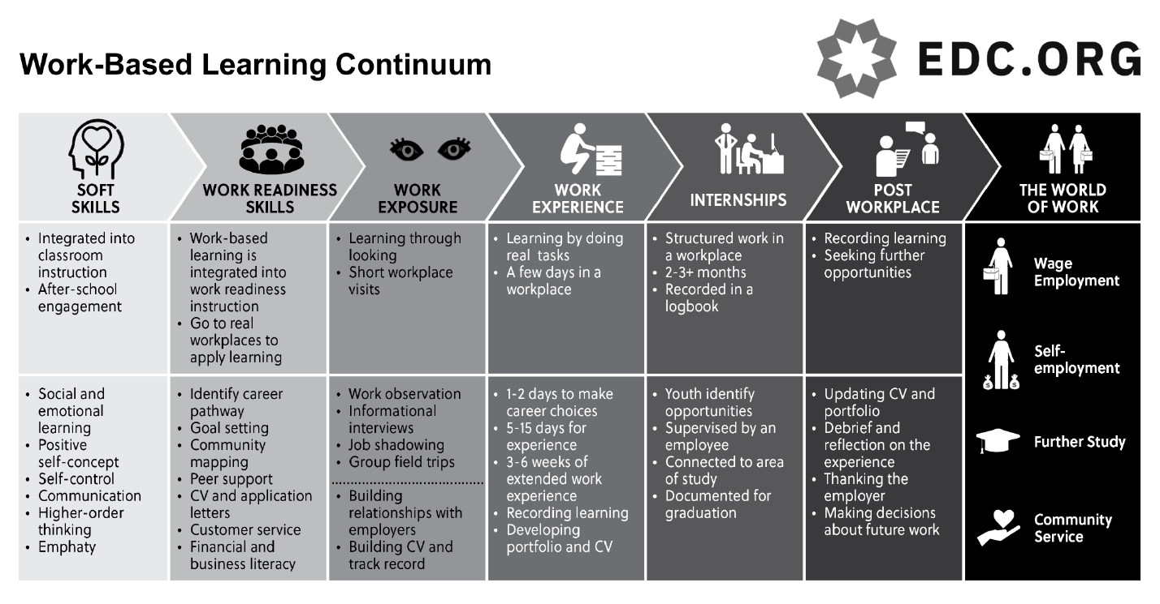
MODULE 1
MODULE 1
COLLABORATIVE EXPERTISE SESSION (CES) GUIDE ON WORK-BASED LEARNING

Slide 30
MODULE 1
MODULE 1
Say: Through work exposure, learners learn by looking and listening. Eventually, the learners do real tasks as they are immersed in work experience.
(Note to the CES facilitator: It would be good to highlight that work exposure and work experience can help the learners reach their goals of finding a job or livelihood. To learn more about the process of Work-Based Learning, refer to “How Does Work-Based Learning Work” section of the Facilitator’s Guide.)
COLLABORATIVE EXPERTISE SESSION (CES) GUIDE ON WORK-BASED LEARNING

Slide 31
MODULE 1
MODULE 1
Say: Before starting, it is important that the ALS teacher, as the Work-Based Learning facilitator, explains the purpose of doing all the activities with the ALS learners. What can the learners achieve upon completing all the tasks? How will this be useful for them? What benefits will they get after finishing the activities? Below are the goals and benefits of work-based learning:
GOALS | BENEFITS
Build a professional network | More job and business opportunities
2. Practice work-related skills | 2. Elevated career prospects
3. Sample different types of work | 3. Avoidance of job mismatch
4. Prepare for internship | 4. Successful internship experience
5. Master job-focused skills | 5. Better preparedness for employment and self-employment
COLLABORATIVE EXPERTISE SESSION (CES) GUIDE ON WORK-BASED LEARNING

Slide 32
MODULE 1
MODULE 1
2. Explaining the facilitator’s role in Work-Based Learning
Say: Your role is to facilitate sessions from the Facilitator’s Guide, not to place learners in workplaces. Instead, empower them to find their own by suggesting people or workplaces they can approach. Community mapping can be a valuable tool for both you and the learners.
3. Setting expectations
Say: Setting expectations involves clearly communicating goals and responsibilities, starting from the first Work-Based Learning session. For details on learner roles, refer to the "What is Expected of Participating Learners?" section in the Facilitator’s Guide. Begin each module by aligning expectations with its objectives.
COLLABORATIVE EXPERTISE SESSION (CES) GUIDE ON WORK-BASED LEARNING

Slide 33
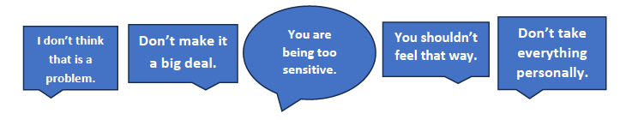
MODULE 1
MODULE 1
4. Being a good communicator
Note to CES facilitator: Some tips on interacting with learners may be found in “Communicating with Learners” section of the Facilitator’s Guide. Encourage the CES members to check those.
Say: Even after going over the Life Skills Modules and other resources, some learners might still have concerns about meeting the expectations. As their facilitator, you need to effectively acknowledge their concerns as a sign of care and support. Avoid downplaying their concerns or invalidating what they feel. Here are some examples of invalidation statements that may unintentionally discourage learners from seeking further guidance:
COLLABORATIVE EXPERTISE SESSION (CES) GUIDE ON WORK-BASED LEARNING

Slide 34
MODULE 1
MODULE 1
Here are some suggestions on what you can do when learners share their concerns:
  Be present. Whether the conversation is face-to-face or online, give your full attention as this is one of the best ways to make them feel heard.
  Let them talk. As facilitators who are very much willing to help our learners, there are instances when we want to react or respond right away. While the intention is good, this may interrupt the learners and keep them from continuing with the conversation. Practice active listening–listen intently first and stay silent while they are still expressing their concerns. This will allow you to better understand where the learner is coming from and offer the right kind of support needed.
  Encourage reflection and offer guidance accordingly. After the learners are done sharing their initial worries, try asking them if they think there is a more specific or underlying reason behind their concern. Make sure learners are given the opportunity to express themselves fully before jumping back into the activities.
COLLABORATIVE EXPERTISE SESSION (CES) GUIDE ON WORK-BASED LEARNING

Slide 35
MODULE 1
MODULE 1
5. Building learner’s capacity
Say: When discussing what is expected from the learners, some of them might not feel confident in finishing the activities. In this situation, some helpful resources include the ALS Life Skills Modules. These are designed to equip the learners with basic knowledge and skills to enhance their ability to find work or start their own business. There are nine modules, namely:
  Module 1 – Personal Development
  Module 2 – Interpersonal Communication
  Module 3 – Leadership and Teamwork
  Module 4 – Work Habits
  Module 5 – Health and Safety at Work
  Module 6 – Rights and Responsibilities
  Module 7 – Financial Fitness
  Module 8 – Exploring Entrepreneurship
  Module 9 – Civic Engagement
COLLABORATIVE EXPERTISE SESSION (CES) GUIDE ON WORK-BASED LEARNING

Slide 36
MODULE 1
MODULE 1
Optional question: How can ALS learners who are undertaking Work-Based Learning activities build on knowledge and skills gained from the ALS Life Skills Modules? (Allot 5 minutes for sharing from the CES members)
Say: Completing the ALS Life Skills Modules equips learners with skills applicable to Work-Based Learning and beyond, encouraging self-reflection on their strengths, making them more productive and engaged. This awareness helps them focus energy on challenges, achieve positive outcomes, and build confidence in their abilities.
COLLABORATIVE EXPERTISE SESSION (CES) GUIDE ON WORK-BASED LEARNING

Slide 37
MODULE 1
MODULE 1
Application
[Total: 20 minutes]
Ask the CES members to go back to the groupings from the previous activities.
Say: Having covered the basics of Work-Based Learning, including work exposure and experience, consolidate your learning by planning upcoming sessions with ALS learners. In small groups, complete the graphic organizer based on insights from this CES (10 minutes).
COLLABORATIVE EXPERTISE SESSION (CES) GUIDE ON WORK-BASED LEARNING

Slide 38
MODULE 1
MODULE 1
Here are samples of what may be written on the graphic organizer:
A series of steps where learners gain gradual experience and responsibility in a workplace [Family Handout 3: Work-Based Learning Frequently Asked Questions (FAQ)
Review all necessary materials and activities before meeting learners (e.g., Module 1 Activity 1, Learner Handout 1: Work-Based Learning Continuum).
Familiarize yourself with facilitation guidelines, objectives, and session timelines.
          Consider the ALS learners’ backgrounds and contextualize discussions accordingly.
Work-Based Learning
What should I know before participating in work-based learning?
How can I prepare for work-based learning?
Share general ideas about the type of workplace they want to explore.
Review relevant handouts (e.g., Learner Handout 1: Work-Based Learning Continuum).
COLLABORATIVE EXPERTISE SESSION (CES) GUIDE ON WORK-BASED LEARNING

Slide 39
MODULE 1
MODULE 1
3. Ask at least two groups to briefly share their filled out graphic organizers to the bigger group.
4. Say: Expect to complete graphic organizers at the end of each CES. Initially, this will be done in groups or pairs, eventually transitioning to individual work. To enhance learning, create personal graphic organizers after each session and take photos of group outputs for reference.
COLLABORATIVE EXPERTISE SESSION (CES) GUIDE ON WORK-BASED LEARNING

Slide 40
MODULE 1
MODULE 1
Assessment Administration Tips
[Total: 10 minutes]
Have CES members complete the Module 1 End-of-Module Assessment to evaluate their understanding. Discuss common errors to address misunderstandings and guide them in writing personal reflections using the reflection sheet.
Process the Work-Based Learning Pre-Test, Session 1 Reflection Sheet, and End-of-Module 1 Assessment based on Module 1 content.
Reassure learners that assessments are not meant to disqualify them but to gauge their knowledge and provide support. The Pre-Test helps facilitators tailor sessions, while the End-of-Module Assessment checks progress and identifies areas needing improvement.
COLLABORATIVE EXPERTISE SESSION (CES) GUIDE ON WORK-BASED LEARNING

Slide 41
MODULE 1
MODULE 1
If learners struggle with certain topics, revisit the Facilitator’s Guide definitions and use answer keys as references. Focus on addressing common mistakes rather than reviewing every item in detail.
Emphasize that Reflection Sheets have no right or wrong answers. They help learners identify challenging concepts and clarify their understanding.
Provide written feedback highlighting strengths and areas for improvement using the Sandwich Method—constructive feedback placed between positive comments.
  Example: “I see that you were able to pick up on the importance of work-based learning [positive feedback]. However, you still seemed confused as to where you want to be placed. You might want to do some more research about the types of workplaces where you could be placed at [negative or constructive feedback], but it’s good that you already have an initial understanding of what needs to be done [positive feedback].”
COLLABORATIVE EXPERTISE SESSION (CES) GUIDE ON WORK-BASED LEARNING

Slide 42
MODULE 1
MODULE 1
Closing
[Total: 5 minutes]
Review the session objectives together with the CES members. Validate if the objectives were met.
Administer the Post-CES Competency Assessment Checklist (Annex B).
Identify the topic, prerequisites, and schedule for the next CES.
Thank the CES members and congratulate them for completing the CES.
Encourage them to ponder once more over their early work experiences and capture this experience by using a quote or mantra that they may share with their ALS learners.
  Some examples of work mantras are as follows:
  “Do not wish for it. Work for it.” - Unknown
  “It always seems impossible until it is done.” - Nelson Mandela
COLLABORATIVE EXPERTISE SESSION (CES) GUIDE ON WORK-BASED LEARNING

Slide 43
COLLABORATIVE EXPERTISE SESSION (CES) GUIDE ON
WORK-BASED LEARNING
MODULE 2
WORK EXPOSURE
This CES guide module complements Module 2 of the Work-Based Learning Facilitator’s Guide. It tackles expanding the concept of “workplaces” in the community and provides practical tips for conducting work observation.

Slide 44
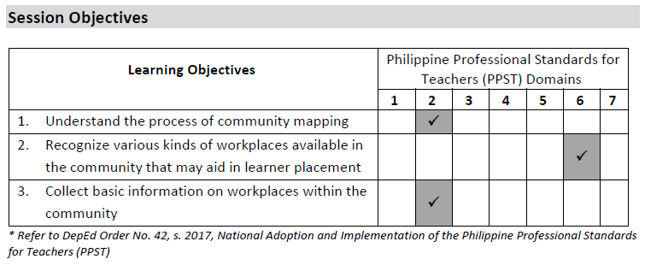
MODULE 2
MODULE 1
COLLABORATIVE EXPERTISE SESSION (CES) GUIDE ON WORK-BASED LEARNING

Slide 45
MODULE 2
MODULE 1
Session Prerequisites
It is ideal that the CES members have already read or browsed relevant sections of the Facilitator’s Guide prior to this CES, particularly:
  Activity 2: Community Mapping
  Activity 3: Work Observation
  Learner Handout 2: Explanation of Workplace Observation (Work Exposure)
  Learner Handout 3: Workplace Observation Form
  Activity 2: Informational Interviews
  Learner Handout 4: Explanation of an Informational Interview (Work Exposure)
Duration
The entire session requires approximately two (2) hours.
COLLABORATIVE EXPERTISE SESSION (CES) GUIDE ON WORK-BASED LEARNING

Slide 46
MODULE 2
MODULE 1
Preliminaries
[Total: 5 minutes]
Accomplish the Pre-CES Competency Assessment Checklist (Annex A).
Provide an overview of the CES.
Go through the session objectives.
Priming Activity
[Total: 10 minutes]
Ask CES members to list all workplaces in their community within two (2) minutes.
Pair them up to compare lists, highlighting potential workplaces for learner observations (5 minutes).
COLLABORATIVE EXPERTISE SESSION (CES) GUIDE ON WORK-BASED LEARNING

Slide 47
MODULE 2
MODULE 1
Main Activity
[Total: 15 minutes]
Ask the CES members to form three (3) groups. Assign them the following Module 2 sections:
  Group 1: Session 2 – Activity 3: Work Observation and Learner Handout 2: Explanation of Workplace Observation (Work Exposure)
  Group 2: Session 2 – Activity 3: Work Observation and Learner Handout 3: Workplace Observation Form
  Group 3: Session 3 – Activity 2: Informational Interviews and Learner Handout 4: Explanation of an Informational Interview (Work Exposure)
Give the groups 15 minutes to go through their assigned sections, paying close attention to the activity objectives, indicated steps, and provided tools. They may also review their list of workplaces.
COLLABORATIVE EXPERTISE SESSION (CES) GUIDE ON WORK-BASED LEARNING

Slide 48
MODULE 2
MODULE 1
Analysis
[Total: 20 minutes]
Ask each group to summarize and present the key points of their assigned activity (3 minutes per group).
After the allotted time for group presentations, ask the following:
  What insights have you gained about Work-Based Learning from the activities?
  How do the activities allow the learners to deepen their understanding of the workplace and preparing for employment?
  Is there any additional information that the learners should know about work observation and informational interviews?
  How might learners find out about different potential workplaces in their local community?
COLLABORATIVE EXPERTISE SESSION (CES) GUIDE ON WORK-BASED LEARNING

Slide 49
MODULE 2
MODULE 1
Abstraction
[Total: 30 minutes]
Say: To better prepare for the delivery of the Work-Based Learning Module 2, let us delve deeper into some concepts already presented in the Facilitator’s Guide:
Finding Workplaces in the Community
While finding workplaces is primarily the learners' responsibility, facilitators can assist by identifying good matches and tracking learner activities. Here are ways to gather additional information about local workplaces:
  Explore: Observe and list workplaces in your area during daily outings. You might discover new or previously unnoticed places.
  Inquire: Ask people you interact with about their workplaces or check with the barangay for a list. Online searches can also help.
  Brainstorm: Collaborate with others to create and regularly update a community workplace list.
COLLABORATIVE EXPERTISE SESSION (CES) GUIDE ON WORK-BASED LEARNING

Slide 50
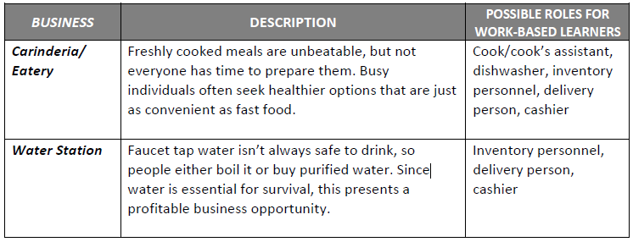
MODULE 2
MODULE 1
2. Considering Small Workplaces for Work-Based Learning
Workplaces don’t have to be large corporations or franchises. Small, local businesses are also suitable for work-based learning opportunities. Below are a few examples of these small-scale businesses as well as possible roles for the ALS learners assigned in such workplaces:
To see additional examples of small workplaces that may be found in your community, refer to Annex C.
COLLABORATIVE EXPERTISE SESSION (CES) GUIDE ON WORK-BASED LEARNING

Slide 51
MODULE 2
MODULE 1
Introducing Community Mapping
Community mapping, as outlined in Activity 2, involves identifying potential workplaces in the community that align with learners' career goals and interests. It increases awareness of various workplace options, from small businesses to multinational companies.
While facilitators are not responsible for placing learners, assisting with community mapping can motivate them and support the completion of their 16-hour work experience.
COLLABORATIVE EXPERTISE SESSION (CES) GUIDE ON WORK-BASED LEARNING

Slide 52
MODULE 2
MODULE 1
Application
[Total: 25 minutes]
Ask the CES members to go back to the groupings from the previous activity.
Say: In the previous CES, we used graphic organizers to map key concepts for ALS learners. Today, we’ll do a similar activity based on new learnings. You’ll have 10 minutes to complete the graphic organizers in small groups.
COLLABORATIVE EXPERTISE SESSION (CES) GUIDE ON WORK-BASED LEARNING

Slide 53
MODULE 2
MODULE 1
Ask the three groups to briefly share their filled out graphic organizers.
Say: Thank you for sharing your graphic organizers. Collaborative exercises are valuable for learning from others, but it’s also recommended to create your own to address your learners’ unique needs. Feel free to take photos of today’s graphic organizers as a reference. In the next CES, you’ll complete graphic organizers in pairs or triads. It may seem challenging at first, but you’ll adapt quickly.
COLLABORATIVE EXPERTISE SESSION (CES) GUIDE ON WORK-BASED LEARNING

Slide 54
MODULE 2
MODULE 1
Assessment Administration Tips
[Total: 10 minutes]
Have CES members complete the Module 2 End-of-Module Assessment to evaluate their understanding, address common errors, and clarify misunderstandings. Encourage them to write personal reflections using the reflection sheet.
Consider how you will process the Reflection Sheet and End-of-Module Assessment based on Module 2 content.
Remind learners there are no right or wrong answers on the Reflection Sheet. Encourage honest responses to identify strengths, peak moments, and areas for improvement.
Use the answer key to review the End-of-Module Assessment and provide feedback using the Sandwich Method, both orally and in writing.
COLLABORATIVE EXPERTISE SESSION (CES) GUIDE ON WORK-BASED LEARNING

Slide 55
MODULE 2
MODULE 1
Closing
[Total: 5 minutes]
Review the session objectives together with the CES members. Validate if the objectives were met.
Administer the Post-CES Competency Assessment Checklist (Annex B).
If necessary, identify the topic and schedule for the next CES.
Thank the CES members and congratulate them for completing the second CES.
Encourage them to reflect on this: On a scale of 1-5 with 1 being the lowest and 5 being the highest, how confident are you that you can help the learners find a workplace? How can you improve that rating so you may be more confident as a learning facilitator?
COLLABORATIVE EXPERTISE SESSION (CES) GUIDE ON WORK-BASED LEARNING

Slide 56
COLLABORATIVE EXPERTISE SESSION (CES) GUIDE ON
WORK-BASED LEARNING
MODULE 3
PREPARING FOR A LONGER TIME IN THE WORKPLACE
This CES guide module complements Module 3 of the Work-Based Learning Facilitator’s Guide. It discusses tips, behaviors or characteristics, and resources needed to succeed in a job search and ensure the learner’s safety in the workplace.

Slide 57
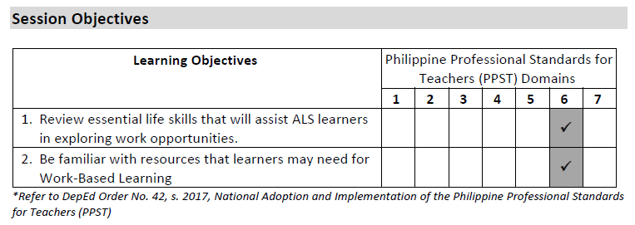
MODULE 3
MODULE 1
COLLABORATIVE EXPERTISE SESSION (CES) GUIDE ON WORK-BASED LEARNING

Slide 58
MODULE 3
MODULE 1
Session Prerequisites
It is ideal that the CES members have already read or browsed relevant sections of the Facilitator’s Guide prior to the conduct of this CES, particularly:
  Learner Handout 6: Ideas for Finding Workplaces
  Activity 2: Life Skills in the Workplace
  Trainer Tool 2: Resources Required for Work-Based Learning
  Learner Handout 9: Explanation of Job Shadowing (Work Exposure)
Duration
The entire session requires approximately two (2) hours.
COLLABORATIVE EXPERTISE SESSION (CES) GUIDE ON WORK-BASED LEARNING

Slide 59
MODULE 3
MODULE 1
Preliminaries
[Total: 5 minutes]
  Accomplish the Pre-CES Competency Assessment Checklist (Annex A).
  Provide an overview of the CES.
  Go through the session objectives.
Priming Activity
[Total: 20 minutes]
Ask the CES members to do the following:
  Pretend that they are a first-time jobseeker in the current year/setting.
  Within two (2) minutes, list down all the tips and methods they could think of to find a job.
  Form four (4) groups and share what they have written down, taking note of the most common ideas within the small group (5 minutes).
  Ask one representative per group to present the three (3) of the most common ideas that surfaced during their discussion (3 minutes per group).
COLLABORATIVE EXPERTISE SESSION (CES) GUIDE ON WORK-BASED LEARNING

Slide 60
MODULE 3
MODULE 1
Main Activity
[Total: 15 minutes]
Using the previous groupings, assign each group to one of the four select materials in Module 3, specifically:
  Learner Handout 6: Ideas for Finding Workplaces
  Activity 2: Life Skills in the Workplace & Learner Handout 7: Life Skills in the Workplace
  Trainer Tool 2: Resources Required for Work-Based Learning
  Learner Handout 9: Explanation of Job Shadowing (Work Exposure)
Give the CES members 10 minutes to go through their assigned section, paying close attention to the activity objectives, indicated steps, and provided tools.
COLLABORATIVE EXPERTISE SESSION (CES) GUIDE ON WORK-BASED LEARNING

Slide 61
MODULE 3
MODULE 1
Analysis
[Total: 20 minutes]
Ask the CES members to summarize and present the key takeaways focusing on the most essential parts (3 minutes per group).
After the presentations, ask the following:
  Reflect on the tips shared during the warm-up activity. Are they applicable to the ALS learners you’ll guide? Why or why not?
  What should ALS learners prepare for when identifying workplaces to observe and learn from?
  What risks and challenges might learners face when finding workplaces to observe, and how can they mitigate these risks?
COLLABORATIVE EXPERTISE SESSION (CES) GUIDE ON WORK-BASED LEARNING

Slide 62
MODULE 3
MODULE 1
Abstraction
[Total: 25 minutes]
Synthesize the output and relate how these group insights contribute to the learners’ ability to build and sustain healthy working relationships.
If necessary, recommend other steps that may help achieve the activity’s objectives when applied during the actual sessions with ALS learners.
COLLABORATIVE EXPERTISE SESSION (CES) GUIDE ON WORK-BASED LEARNING

Slide 63
MODULE 3
MODULE 1
Application
[Total: 20 minutes]
1. Say: Form pairs or triads and complete a graphic organizer based on today’s learnings, just like in previous CES sessions. You won’t present to the group immediately; further instructions will follow. You have 10 minutes.
COLLABORATIVE EXPERTISE SESSION (CES) GUIDE ON WORK-BASED LEARNING

Slide 64
MODULE 3
MODULE 1
After 10 minutes, have pairs/triads exchange graphic organizers. Allow five (5) minutes for members to review and note good practices to adapt, as well as provide suggestions for improvement.
Once the review is complete, return the graphic organizers to their original owners. Ask up to three (3) volunteers to share their outputs and any comments received. Highlight promising action steps or probe interesting points if time allows.
Conclude by thanking the volunteers and acknowledging the growing comprehensiveness of the graphic organizers.
(Note to the CES facilitator: you may include some more personalized feedback on the overall quality of the graphic organizers so far, if appropriate. Use the Sandwich Method when giving feedback.)
Say: Please keep up the good work and feel free to take photos of today’s graphic organizers. You may find them handy when making your own.
COLLABORATIVE EXPERTISE SESSION (CES) GUIDE ON WORK-BASED LEARNING

Slide 65
MODULE 3
MODULE 1
Assessment Administration Tips
[Total: 10 minutes]
Have CES members complete the Module 3 End-of-Module Assessment to evaluate their understanding, address common errors, and clarify misunderstandings. Encourage them to write personal reflections using the reflection sheets.
Reassure learners that the three (3) Reflection Sheets for Sessions 4-6 are not evaluations but tools to capture their insights and learnings.
For the Session 4 Reflection Sheet, guide learners to visualize their target job options and relate them to their interests, helping clarify their goals for job placement.
COLLABORATIVE EXPERTISE SESSION (CES) GUIDE ON WORK-BASED LEARNING

Slide 66
MODULE 3
MODULE 1
For the Session 5 Reflection Sheet, suggest using answers from Session 4 as a reference for their thought process.
For the Session 6 Reflection Sheet, encourage honest responses, especially about challenges and ways to overcome them, as these will serve as valuable future references.
Use the answer key to process the End-of-Module Assessment and encourage learners to seek clarification on difficult concepts. Provide feedback using the Sandwich Method.
Congratulate learners on being more than halfway through the Work-Based Learning modules.
COLLABORATIVE EXPERTISE SESSION (CES) GUIDE ON WORK-BASED LEARNING

Slide 67
MODULE 3
MODULE 1
Closing
[Total: 5 minutes]
Review the session objectives together with the CES members. Validate if the objectives were met.
Administer the Post-CES Competency Assessment Checklist (Annex B).
As may be necessary, identify the topic and schedule for the next CES session.
Thank the CES members and congratulate them for completing the 3rd CES session.
Encourage them to write down a quote or affirmation that motivates them to do their work well. They may share this with their learners as they facilitate the Work-Based Learning sessions.
COLLABORATIVE EXPERTISE SESSION (CES) GUIDE ON WORK-BASED LEARNING

Slide 68
COLLABORATIVE EXPERTISE SESSION (CES) GUIDE ON
WORK-BASED LEARNING
MODULE 4
DOCUMENTING WORK EXPERIENCE
This CES guide module complements Module 4 of the Work-Based Learning Facilitator’s Guide. It focuses on documenting and evaluating the learners’ work experience.

Slide 69
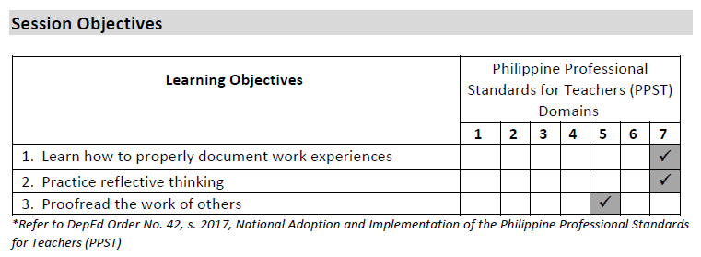
MODULE 4
MODULE 1
COLLABORATIVE EXPERTISE SESSION (CES) GUIDE ON WORK-BASED LEARNING

Slide 70
MODULE 4
MODULE 1
Session Prerequisites
It is ideal that the CES members have already read or browsed relevant sections of the Facilitator’s Guide prior to this CES, particularly:
  Activity 2: What is Work Experience
  Trainer Tool 4: The Purpose of Work Experience
  Activity 3: Preparing for Work Experience
  Learner Handout 12: Informative Meeting with a Potential Host Employer
  Learner Handout 13: Informative Meeting with a Potential Host Employer – Preparation Worksheet
  Learner Handout 14: Work Experience Preparation Checklist
  Employer Handout 2: Employer Agreement with a Learner
  Learner Handout 15: ALS Program Learner Work Placement Agreement
  Learner Handout 17: Record of Work Experience
Duration
The entire session requires approximately two (2) hours.
COLLABORATIVE EXPERTISE SESSION (CES) GUIDE ON WORK-BASED LEARNING

Slide 71
MODULE 4
MODULE 1
Preliminaries
[Total: 5 minutes]
  Accomplish the Pre-CES Competency Assessment Checklist (Annex A).
  Provide an overview of the CES.
  Go through the session objectives.
Priming Activity
[Total: 25 minutes]
  Ask CES members to recall the definition, purpose, and preparation for work experience, referring to Activities 2 and 3 of the Facilitator’s Guide (5 mins).
  Divide CES members into three (3) groups. Have each group discuss how they document work experiences (e.g., reports, journals, emails, notes) and write responses on meta cards (one idea per card) or the board if meta cards are unavailable (10 mins).
  Groups discuss successes and challenges in documenting work experiences (notes only, no meta cards).
  Post meta cards or write responses on the board/wall.
COLLABORATIVE EXPERTISE SESSION (CES) GUIDE ON WORK-BASED LEARNING

Slide 72
MODULE 4
MODULE 1
Main Activity
[Total: 15 minutes]
Ask the CES members to do the following:
Bring out a copy of Learner Handout 17: Record of Work Experience.
In 10 minutes, complete the form based on the work done recently. The meta cards on the board may be used for reference.
Exchange handouts with a seatmate.
Proofread the work of the seatmate for five (5) minutes.
Return the handouts to the original owner.
COLLABORATIVE EXPERTISE SESSION (CES) GUIDE ON WORK-BASED LEARNING

Slide 73
MODULE 4
MODULE 1
Analysis
[Total: 20 minutes]
As a big group, discuss the experience in filling out the handout and proofreading the work of others (allot 5 minutes for the discussion).
After the discussion, ask the following:
  Why do you think documenting your work experiences is important?
  Based on your group discussions, what are the common good practices and challenges in documenting work experiences?
  What do you think is the role of proper documentation in one’s career growth?
Synthesize the responses and relate how documenting work experiences is an important skill that ALS learners should learn as they go through the Work-Based Learning activities.
COLLABORATIVE EXPERTISE SESSION (CES) GUIDE ON WORK-BASED LEARNING

Slide 74
MODULE 4
MODULE 1
Abstraction
[Total: 15 minutes]
Say: ALS learners need strong documentation skills for job applications. Learner Handout 17: Record of Work Experience must be completed daily, detailing personal/professional information, activities, tasks, new skills/knowledge, and tools or equipment used.
Here are some additional tips for the learners on how to properly document their tasks:
Gather Background Information: Ensure accuracy for the company name, address, sector, contact person’s name, position, and contact number.
Set and Track the Schedule: Record daily dates, time in/out, and hours worked to easily calculate total hours.
COLLABORATIVE EXPERTISE SESSION (CES) GUIDE ON WORK-BASED LEARNING

Slide 75
MODULE 4
MODULE 1
Document Daily Activities: Log tasks, tools, and equipment used with complete and accurate details at the end of each day for clarity when supervisors review.
Reflect on the Day: Assess new knowledge/skills learned and evaluate if the job aligns with personal goals. Ask, “What new knowledge and/or skills did I learn today?” Reflection becomes easier with practice.
Proofread Carefully: Double-check spelling and grammar before requesting a supervisor's signature. Peer proofreading is helpful.
Organize and Back Up Files: File signed documents properly and keep digital copies for security and easy retrieval.
COLLABORATIVE EXPERTISE SESSION (CES) GUIDE ON WORK-BASED LEARNING

Slide 76
MODULE 4
MODULE 1
Application
[Total: 30 minutes]
Say: Just like in the previous CES, please form pairs or triads. In ten minutes, fill out your graphic organizes based on today’s discussions.
COLLABORATIVE EXPERTISE SESSION (CES) GUIDE ON WORK-BASED LEARNING

Slide 77
MODULE 4
MODULE 1
Exchange and Review: Pairs/triads exchange graphic organizers, review them for good practices, and note suggestions for improvement (10 mins).
Share and Discuss: Return organizers to original owners; up to three (3) volunteers share their outputs and feedback received. Discuss briefly if time allows.
Document Takeaways: Encourage members to take photos or notes of key insights to apply to their own graphic organizers.
COLLABORATIVE EXPERTISE SESSION (CES) GUIDE ON WORK-BASED LEARNING

Slide 78
MODULE 4
MODULE 1
Assessment Administration Tips
[Total: 10 minutes]
End-of-Module Assessment: Have CES members complete the Module 4 assessment to gauge understanding. Discuss common errors, clarify misunderstandings, and encourage personal reflections using the reflection sheet questions.
Reflection Sheets Overview: Monitor learners' confidence in completing the three reflection sheets for Sessions 7-9, offering support as needed to help them capture and process their experiences.
Session 7 Reflection: Suggest learners conduct personal research (e.g., online or through networks). Remind them that success requires discipline and consistent effort.
COLLABORATIVE EXPERTISE SESSION (CES) GUIDE ON WORK-BASED LEARNING

Slide 79
MODULE 4
MODULE 1
Session 8 Reflection: Encourage vivid descriptions and self-review of routines to optimize habits, such as adjusting sleep or travel schedules.
Session 9 Reflection: Promote honesty in workplace evaluations and assure learners of alternatives if current conditions are unsuitable (e.g., work culture, temperament of workers, unreasonably rigid rules). Be prepared for serious issues (e.g., bullying, discrimination, harassment) requiring private discussions or professional support.
Feedback and Clarifications: Use the answer key to guide discussions on assessment results. Encourage learners to ask about difficult concepts and provide feedback using the Sandwich Method.
COLLABORATIVE EXPERTISE SESSION (CES) GUIDE ON WORK-BASED LEARNING

Slide 80
MODULE 4
MODULE 1
Closing
[Total: 5 minutes]
Review the session objectives together with the CES members. Validate if the objectives were met.
Administer the Post-CES Competency Assessment Checklist (Annex B).
If necessary, identify the topic and schedule for the next CES.
Thank the CES members and congratulate them for completing the 4th CES.
Encourage them to ponder over this reflection activity outside of the CES: What counts as today’s rose, thorn, and bud?
  Rose - a small win or accomplishment
  Thorn - a challenge you faced
  Bud - something you are looking forward to
For the last CES, instruct the CES members to bring their own bio-data or curriculum vitae.
COLLABORATIVE EXPERTISE SESSION (CES) GUIDE ON WORK-BASED LEARNING

Slide 81
COLLABORATIVE EXPERTISE SESSION (CES) GUIDE ON
WORK-BASED LEARNING
MODULE 5
FORWARD PLANNING
This CES guide module complements Module 5 of the Work-Based Learning Facilitator’s Guide. It tackles support for learners and possible ways forward upon completing the Work-Based Learning activities.

Slide 82
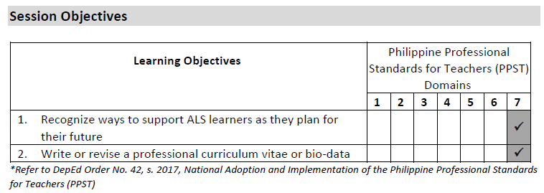
MODULE 5
MODULE 1
COLLABORATIVE EXPERTISE SESSION (CES) GUIDE ON WORK-BASED LEARNING

Slide 83
MODULE 5
MODULE 1
Session Prerequisites
It is ideal that the CES members have already read or browsed relevant sections of the Facilitator’s Guide prior to this CES, particularly:
Activity 1: Debriefing Work Experience
Activity 3: Reflecting on Work-Based Learning
Activity 4: Forward Planning
Learner Handout 18: My Career Growth Action Plan
Duration
The entire session requires approximately two (2) hours.
COLLABORATIVE EXPERTISE SESSION (CES) GUIDE ON WORK-BASED LEARNING

Slide 84
MODULE 5
MODULE 1
Preliminaries
[Total: 5 minutes]
Accomplish the Pre-CES Competency Assessment Checklist (Annex A).
Provide an overview of the CES.
Go through the session objectives.
Priming Activity
[Total: 10 minutes]
Ask the CES members to:
Reflect on their current professional and/or personal situation.
Visualize what they aim to accomplish (goals) in three years’ time.
Write 1-3 goals on a sheet of paper.
Form four (4) groups and share the identified goals within the small groups.
COLLABORATIVE EXPERTISE SESSION (CES) GUIDE ON WORK-BASED LEARNING

Slide 85
MODULE 5
MODULE 1
Main Activity
[Total: 10 minutes]
Ask the CES members to return to their small groups. Each group will be assigned one of the 4 materials in Module 5 – Session 10 in the Facilitator’s Guide, specifically:
  Activity 1: Debriefing Work Experience
  Activity 3: Reflecting on Work-Based Learning
  Activity 4: Forward Planning
  Learner Handout 18: My Career Growth Action Plan
Give the CES members 10 minutes to go through their assigned section, paying close attention to the activity objectives and indicated steps.
COLLABORATIVE EXPERTISE SESSION (CES) GUIDE ON WORK-BASED LEARNING

Slide 86
MODULE 5
MODULE 1
Analysis
[Total: 30 minutes]
Ask the CES members to summarize and present the key takeaways focusing on the most essential parts (5 minutes per group).
After the discussion, ask the following:
  What insights can you share about goal setting from the priming activity?
  Why is goal setting an important skill that ALS learners should practice as part of their career life journey?
  If you were a learner, would you find the Module 5 materials easy to understand, appreciate, and complete? What improvements are necessary, if any?
COLLABORATIVE EXPERTISE SESSION (CES) GUIDE ON WORK-BASED LEARNING

Slide 87
MODULE 5
MODULE 1
Synthesize the groups’ insights and answers before wrapping up the discussion.
Say: Endings can leave individuals feeling uncertain about their next steps. After completing their work experience, learners need guidance on moving forward, which is the focus of Module 5. Facilitators should also develop skills to nurture career growth. Next, engage in an application exercise tailored to professional needs—please prepare your curriculum vitae or bio-data.
COLLABORATIVE EXPERTISE SESSION (CES) GUIDE ON WORK-BASED LEARNING

Slide 88
MODULE 5
MODULE 1
Abstraction
[Total: 30 minutes]
Ask the CES members to do the following:
Bring out their CVs/bio-data and carefully go through the items written.
Optional: Watch this video on writing a CV: How to Write a CV for a Job Application: Step by Step Guide | Indeed Career Tips (Link: https://youtu.be/QhYvD0RGCHc)
COLLABORATIVE EXPERTISE SESSION (CES) GUIDE ON WORK-BASED LEARNING

Slide 89
MODULE 5
MODULE 1
Have them check if their individual CV/bio-data has the following parts:
  Correct and updated contact information (e.g., email address, phone number)
  Academic history from high school to undergraduate/graduate level
  Professional experiences such as workplaces and organizations wherein they took on both paid and voluntary work; highlight any major contributions to these workplaces
  Qualifications and skills, both soft and hard/technical skills
  Awards and honors (if applicable)
  Publications and presentations (if applicable)
  Professional associations (if applicable)
  Grants and scholarships (if applicable)
  Licenses and certificates (if applicable)
COLLABORATIVE EXPERTISE SESSION (CES) GUIDE ON WORK-BASED LEARNING

Slide 90
MODULE 5
MODULE 1
Ensure CV/bio-data contents are updated, accurate, and truthful. Highlight notable contributions without exaggeration. Check for errors in spelling, grammar, and formatting to maintain professionalism. Verify personal details, such as address, contact number, and marital status, are current.
After 10 minutes of updating their CVs/bio-data, have members exchange and review each other’s work for five (5) minutes, offering clarifications or suggestions for improvement.
Return CVs to their owners and provide feedback using the Sandwich Method.
COLLABORATIVE EXPERTISE SESSION (CES) GUIDE ON WORK-BASED LEARNING

Slide 91
MODULE 5
MODULE 1
Application
[Total: 25 minutes]
Say: We now proceed to the final graphic organizer. In the previous sessions, you have tried filling out graphic organizers by group, pair, or triad. Now, it is time for you to try it out on your own. You have ten minutes to fill out your individual graphic organizers. Have fun!
COLLABORATIVE EXPERTISE SESSION (CES) GUIDE ON WORK-BASED LEARNING

Slide 92
MODULE 5
MODULE 1
Exchange and Review: After 10 minutes, have CES members exchange graphic organizers with their seatmates. Allow 10 minutes for review, noting good practices, and providing suggestions for improvement.
Share and Discuss: Return graphic organizers to the owners. Invite up to three volunteers to share their work and any feedback received, with a brief discussion if time permits.
Document Insights: Encourage members to take photos or notes of key takeaways to apply to their own graphic organizers.
Say: It is good to see how much you as CES members and Work-Based Learning facilitators have learned in the past sessions.
(Note to the CES facilitator: You may include some more personalized feedback on the overall quality of the graphic organizers so far, if appropriate. Use the Sandwich Method when giving feedback.)
Say: I hope that these notes will be helpful to you as you facilitate your sessions with the ALS learners.
COLLABORATIVE EXPERTISE SESSION (CES) GUIDE ON WORK-BASED LEARNING

Slide 93
MODULE 5
MODULE 1
Assessment Administration Tips
[Total: 10 minutes]
Complete Assessments: Have CES members complete the Module 5 End-of-Module Assessment to check understanding. Discuss common errors and clarify misunderstandings. Encourage personal reflections using the reflection sheet.
Reflection and Post-Test: Guide learners through the single Reflection Sheet, End-of-Module Assessment, and Work-Based Learning Post-Test, emphasizing that the post-test is not graded but highlights growth. Use the answer key for discussions.
Celebrate Achievements: Congratulate learners on completing Work-Based Learning, recap highlights, and commend their dedication to boost confidence.
Encourage Reflection: Urge learners to honestly capture thoughts in the Reflection Sheet. Note shared experiences and feedback for future sessions.
Empower Continued Learning: Reinforce the use of Self-Directed ALS Life Skills Modules as independent learning resources.
Provide Feedback: Offer written feedback on strengths and areas for improvement.
COLLABORATIVE EXPERTISE SESSION (CES) GUIDE ON WORK-BASED LEARNING

Slide 94
MODULE 5
MODULE 1
Closing
[5 minutes]
Reflect on Learnings: Ask CES members to recall knowledge and experiences from the sessions.
Identify an Aha! Moment: Encourage them to note a key learning or experience to carry forward in facilitating Work-Based Learning activities.
Document Insights: Have them write their Aha! Moment in their facilitator’s notes.
Review Objectives: Discuss session objectives and confirm if they were met.
Complete Assessment: Administer the Post-CES Competency Assessment Checklist (Annex B).
Express Gratitude: Thank and congratulate CES members for completing the sessions.
Encourage Continued Growth: Urge them to explore the Facilitator’s Guide Information Sheets to enhance their skills further.
COLLABORATIVE EXPERTISE SESSION (CES) GUIDE ON WORK-BASED LEARNING

